Slide 1
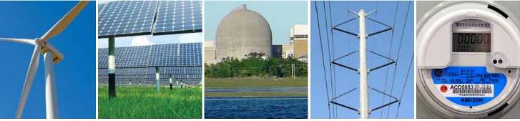
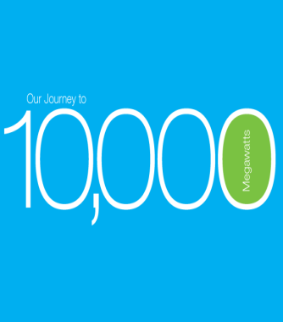
A Philosophy:
Maximizing Wind and Solar Energy
Mark Ahlstrom - WindLogics/NextEra Energy
WCEA - San Francisco
January 8, 2015

Slide 2
My Personal Philosophy
The Prime Directive:
I also believe:
Wind and solar plants must be fully capable power plants
Unit commitment and dispatch provide elegant solutions for renewable integration and system optimization
Adding renewables does not significantly increase system ramping or reserve costs
Maximize wind/solar penetration in the power system

Slide 3
Background
WindLogics (subsidiary of NextEra Energy Resources)
  Computing, meteorology and applied math folks
  Forecasting & optimization solutions that enable low cost, reliable & sustainable power systems
NextEra Energy, Inc. (NYSE: NEE)
  NextEra Energy Resources (NEER)
    Largest generator of wind and solar energy in North America
  Florida Power & Light (FPL)
    Large rate-regulated electric utility (4.7 million accounts)
  Hawaiian Electric (definitive agreement, pending)

Slide 4
Internal Efforts
WindLogics
  Wind, solar, integration, and related work since 2002
Emerging Technology Implications Working Group
  A cross-company working group created in early 2014
  Active members from our NERC, FERC, FPL planning, FPL system operations, transmission, generation, legal, business management, distributed generation, and WindLogics groups
  Mission and goals:
    Identify and influence “technical policy” issues related to disruptive changes to the power system
    Correct misconceptions, educate decision makers, and understand the future landscape

Slide 5
Some Active Areas
NERC Essential Reliability Services Task Force (ERSTF)
  Is the transition to less coal, more gas, more renewables and more demand response a threat to reliability? Specifically:
      Frequency support (inertial response & frequency response)
      Voltage support (reactive power)
      Ramping (mostly CAISO’s concern… we’ll discuss why later)
EPA Clean Power Plan
  Reports from system operators are quite negative
      Reality, or positioning to get support for the transition?
  NERC reports are very negative
      Influence of coal utilities and consultants
Solar, distributed generation, and IEEE 1547

Slide 6
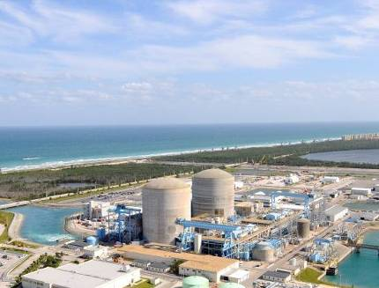
All Generators Impose Operating Constraints
Every resource has operating constraints that reflect characteristics of fuel and technology
Conventional limitations
  Start-up times & costs
  Minimum run times
  Operating ranges
  Ramp rate limitations
  Forced outages & contingencies
Fuel supply characteristics matter… for gas, nuclear, wind, solar, etc.
The challenge of Variable Energy Resources (VER) is a bit different, but not unique

Slide 7
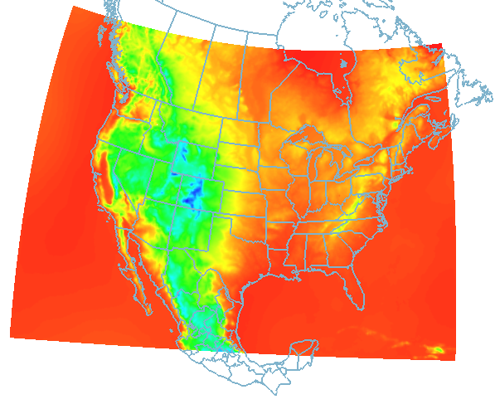
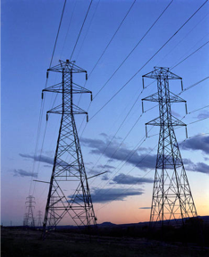
Unit Commitment and Dispatch
Unit commitment and dispatch is a rolling optimization process
“Dispatchable” does not mean being able to provide any desired amount of power at any specified time
Dispatch is not arbitrarily telling a generator
what to produce…
It is knowing what is available for the dispatch period
and optimizing the system as a whole

Slide 8
Most Wind in North America is Dispatched Today
Most ISO/RTO systems now include wind in Day Ahead Unit Commitment and Security Constrained Economic Dispatch (SCED)
Wind dispatch done with a 10-minute-ahead forecast or faster
  Using the current telemetered value (“persistence” forecast)
    NYISO, ERCOT, SPP
  Using a rolling five-minute forecast (“persistence + model” forecast)
    MISO, PJM, IESO
Not a markets issue (markets may help, but this works anywhere)
  Forecast wind into day ahead unit commitment
  Dispatch the entire system (including wind) every five minutes using a very short term wind forecast or the current telemetered output value

Slide 9
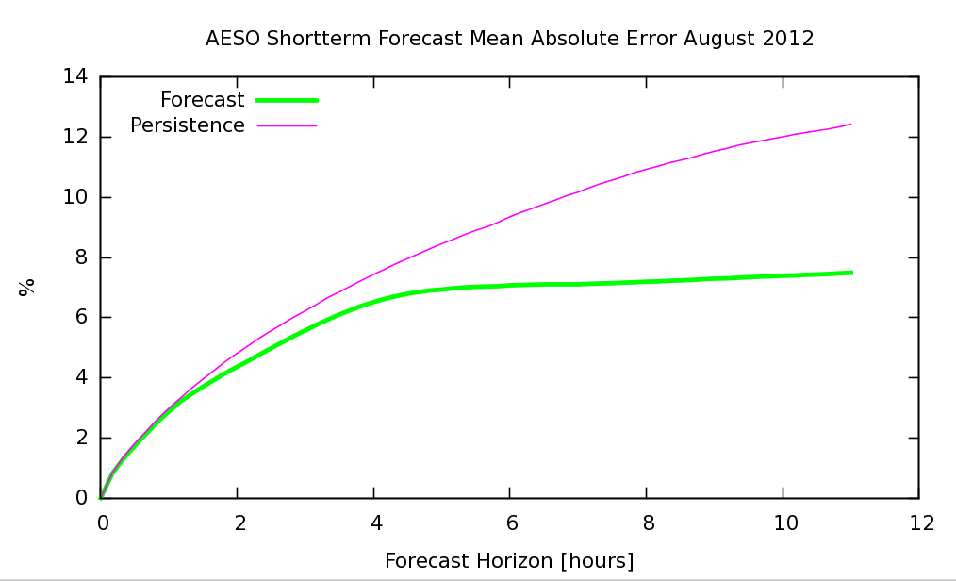
Why is “10 minutes or less” Important?
The Wind Forecast Error Curve
System-wide
Error (% MAE)
9
From: Jacques Duchesne, AESO
Notes:
Forecast beats persistent after about 1 hour.
Graphs shows aggregate results. Individual wind farm error can be twice as high.

Slide 10
Dispatching Wind Changes the Perception of the Problem
“Variability” is the change or error within the dispatch period
Uses a small amount of regulation
“Uncertainty” is mostly the error from the day-ahead forecast
Largely handled through the real time dispatch stack
May use some non-spin reserve for extreme situations
Is there a ramping or flexibility problem?
With a deep and robust real time dispatch… not really
        Wind ramping up - you have dispatch control of wind if needed
        Wind ramping down - units backed down & have room to move up
The concept of “net load” becomes irrelevant when wind and solar are dispatched
Notes:
Joe Gardner from MISO:
MISO has never called for operating reserve as a result of the loss of or changes to wind generation
MISO feels that they do not face significant operational issues associated with wind because their 14,000 MW of installed wind capacity is nicely dispersed throughout their operating area
The largest wind generation observed in real-time is about 11,000 MW
The largest sudden loss of wind generation in MISO to-date has been about 2,000 MW (which did not cause any operational issues)
Forecasting for wind sites in MISO is done on a site-by-site basis (similar to ERCOT)
MISO feels that while their forecasting is not always right on the mark, generally the trend that is generated is pretty much always right (generation going up or generation going down)

Slide 11
Wind and Solar Plants are Power Plants
Dispatchable
  Easy if done right, high errors if “fuel characteristics” are ignored
Ride through disturbances
  Wind ride-through requirements exceed those of conventional generators per NERC Standard PRC-024
Provide frequency response and voltage control
  Implemented for wind in ERCOT and other regions
Impressive ramping and active power control
  Very fast and accurate response over entire capability range
Utility-scale solar plants can support similar capabilities

Slide 12
General Recommendations
Install reliability services capabilities in new wind & solar
  All power plants should contribute in ways that make economic sense given their fuel and technology characteristics
  All power plants should ride through disturbances, but we do not expect every plant to provide every reliability service at all times
Support performance-based, technology-neutral standards
  Focus on operating performance outcomes
    Discretion on how to achieve performance requirements
We will learn and adapt as the generation mix changes
  These are good engineering problems

Slide 13
My Personal Approach
Leverage insider status - carefully catalyze change
Perception is reality, so use this to advantage
  Be obsessive about nomenclature
  Manage the tone and the message
Perspective matters
  Elegant solutions are possible
  Exploit opportunities to change the status quo
One of Cicero’s Six Mistakes of Man:
Insisting that a thing is impossible because we cannot accomplish it

Slide 14
Discussion
Mark Ahlstrom
651-556-4262
mark@windlogics.com

Slide 15
The Short Term Wind Forecast Error Curve
System-wide
Error (% MAE)
Time (Hours)
15
Adapted from Jacques Duchesne, AESO
Notes:
Forecast beats persistent after about 1 hour.
Graphs shows aggregate results. Individual wind farm error can be twice as high.

Slide 16

Example - Midcontinent ISO (MISO) Market
MISO runs a fairly standard “Day Two” market system:
  Submit day-ahead offer
  Some ability to adjust day-ahead offers until 4 hours ahead
  Submit real time offer
      Submitted 30 minutes in advance of each operating hour
  Follow five-minute dispatch signal from MISO (+/- 8% band)
Dispatch & curtailment are based on offer prices (offers “set price”) and reliability needs (security constrained economic dispatch)
16

Slide 17
MISO Dispatchable Intermittent Resource Tariff
MISO runs a fairly standard “Day Two” market system:
  Submit day-ahead offer
  Some ability to adjust day-ahead offers until 4 hours ahead
  Submit real time offer
      Wind provides a rolling five-minute forecast for the next hour
      The 10-minute-ahead forecast value is used for each 5-minute dispatch
  Follow five-minute dispatch signal from MISO (+/- 8% band)
Dispatch & curtailment are based on offer prices (offers “set price”) and reliability needs (security constrained economic dispatch)
17

Slide 18
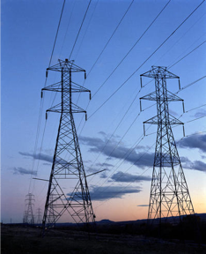
Best Operating Practices for Integrating Variable Generation
Recommendations of numerous studies¹
Larger balancing areas
Shorter scheduling intervals
Better use of flexibility from the
entire power system²
Integrate wind and solar forecasts into tools and markets
Review causes and incentives that lead to system inflexibility…
many are not physical in nature
See http://variablegen.org/resources/
Integration studies have not shown that storage is needed to integrate wind, nor have
the benefits of storage been sufficient to justify building new storage... at least not yet!
18

Slide 19
Wind Power Plant Reliability Services
Standard features today:
Zero voltage ride through (PRC-024 Standard)
Reactive (+/- 0.95 power factor)
Available today:
Reactive power
  Inverter/power electronics can provide reactive power even when the turbine is not generating real power
Synthetic inertia
  Very fast frequency response
  Uses turbine’s kinetic energy for very rapid power injection
Fast and accurate power control over entire capability range
  Very fast downward regulation, ramping, and primary frequency response
  When curtailed for headroom, very fast upward regulation, ramping, and frequency response
Incentives don’t currently encourage use of full capabilities

Slide 20
When is VER Integration Easier?
Large system with diverse and dispersed generation fleet
Majority of generators are dispatched every five minutes
VER plants are efficiently dispatched (using a forecast that reflects their implicit resource characteristics)
Generators (including VER) with ride through capabilities
Most generators (including VER) provide reactive support
Even with a slow-ramping fleet (e.g., mostly coal plants), ramping is not a concern
    Ramping capability actually increases during periods of high VER output because other units are backed down
A few examples: MISO, several other ISOs, some balancing areas

Slide 21
When is VER Integration Harder?
Inefficient VER dispatch
    Using hour- or day-ahead forecasts
    Lack of visibility and control
Limited export and interchange capabilities
Minority of generators dispatched or offering flexibility
    Generation is self-scheduled or viewed as “can’t touch”
    Incentives discourage using/building flexibility
    “Inflexible floor” pushes other generation out of dispatch and creates a min-gen situation when VER output is high
System-wide constraints may make it difficult to commit flexibility and maintain a robust dispatch stack, creating “ramp scarcity”

Slide 22
Is Solar Different that Wind?
Wind is mostly an uncertainty challenge
Solar is more of a variability challenge
Aggregation greatly reduces both issues
Same “integration best practices” apply
Even at 30-50% penetrations (wind+solar),
studies show reliable operation with minimal curtailment of VER resources¹ and no fundamental stability issues introduced by VER²
As with any system reengineering scenario, we will need appropriate transmission upgrades, all power plants (including VER) should contribute to reliability, and local issues must be addressed through generator interconnection requirements
New studies to watch: DOE ERGIS and WWSIS, forthcoming MRITS (Minnesota/MISO)
See forthcoming WWSIS Phase III and MRITS reports for stability/disturbance results
22

