Slide 1
Influencing Air And Energy Regulators: How EE/RE Keep the Beer Cold, the Shower Hot, and Improve Air, Land and Water Quality
Presented to Western Clean Energy Advocates
San Francisco, CA2015 January 9
Christopher James, Principal
2015-01-09
Notes:
Story- Pogo problem
fill niche
we want people to "kick the tires", try out the tool

Slide 2


Introduction
The Regulatory Assistance Project (RAP) is a global, non-profit team of energy experts, mostly veteran regulators, advising current regulators on the long-term economic and environmental sustainability of the power and natural gas sectors. (www.raponline.org)
  Non-advocacy; no interventions
Chris James is a Principal at RAP. His experience as an air quality regulator came as Director for the State of Connecticut and at EPA Region 10 in Seattle.

Slide 3
Conclusions
Scores of EE and RE “power plants” need to be built to reduce GHG and criteria pollutants and impact to other media, and to replace output from retiring fossil-fueled plants
EE and RE power plants reduce risk and volatility, are a least-cost option to maintain and improve reliability, and begin to provide benefits as soon as the first measures are installed
  Wind is competitive with gas and coal, solar costs rapidly declining and competing in some areas
Air regulators are key actors to enable this outcome, but need help to see how EE and RE power plants would be built, operated and evaluated
Notes:
…many areas of the US, Texas, most of the West, have water constraints that equal or exceed their air quality concerns. 10-20% of the energy consumed in Western states is to move water. EE also can reduce water consumption.
States that adopt and implement EE/water linked measures can take GHG credit for the emissions savings if they are appropriated quantified and verified.
The corollary to an EE power plant, a fossil fueled plant, must be 100% completed before 1 MWh of electricity can be generated.

Slide 4
What Is 111(d)?
History:
  endangerment finding
  Waxman-Markey etc., not enacted
EPA compelled to act under Clean Air Act
CO₂ is not criteria pollutant (normal SIP procedure not available)
Section 111 authorizes EPA to regulate non-criteria pollutants

Slide 5
Basis of 111(d)
42 U.S. Code § 7411 (a) (1), “The term ‘standard of performance’ means a standard for emissions of air pollutants which reflects the degree of emission limitation achievable through the application of the best system of emission reduction which (taking into account the cost of achieving such reduction and any non air quality health and environmental impact and energy requirements) the Administrator determines has been adequately demonstrated.”
111(d) complements earlier action by EPA to establish performance standards for new power plants
Limited experience: prior to 2014, 111(d) plans required for pulp and paper, municipal waste combustors, mercury emissions (overturned by Supreme Court-not due to 111(d))

Slide 6
111(d) vs. Criteria Pollutant Programs
Criteria pollutants (ozone, PM): standard setting cannot consider cost
111(d) standard: EPA must consider cost, impact/benefits to environment (water quality, land, other air pollutants), energy impacts and benefits to public health

Slide 7
State 111(d) Compliance Plans:
The Actual Opportunity
Conventional Wisdom:
Actual Opportunity:
+
+
+
+
=
State Compliance
1
2
3
4
Beyond
Each BB likely > 0
Some BBs may be 0…
Keys:
“Better to seek ‘approval’ than to ask permission”
EPA can’t promote “Beyond BB” options…
If you don’t focus on least-cost, who will?
Notes:
The Clean Air Act requires EPA to identify “the best system of emission reduction which (taking into account the cost of achieving such reduction and any non-air quality health and environmental impact and energy requirements) the Administrator determines has been adequately demonstrated.” EPA determined that, for the affected EGUs, the BSER consists of four building blocks. Inside the fence, EPA determined that emissions of coal-fired steam EGUs could be reduced through heat rate improvements. Outside the fence, EPA determined that emissions of all affected EGUs could be reduced by dispatching low-emitting NGCC units more frequently, by adding renewables to the generation portfolio, and by reducing total demand through energy efficiency.
EE = Energy Efficiency
DSM = Demand-Side Management
EERS = Energy Efficiency Resource Standard

Slide 8
Speak Like an Air Regulator to Add Value to EE and RE programs
EE measures, projects, programs and portfolios can be evaluated, measured and verified with sufficient precision*
Savings can persist for entire measure life
EE projects and behind the meter RE can be targeted to coincide geographically and temporally with locations and times of poorest air quality (if desired)
Learn to speak in tons (of pollutants removed or avoided)
Why should clean energy advocates care?
Notes:
The authors are aware that “precision” is a loaded term. The context here is for air quality purposes. EPA has long used a hierarchical scheme to credit emissions savings based on the precision of their measurement.
There are many excellent examples of EM&V (NEEP and the PNW Regional Technical forum to name two) that would be consistent with EPA “A” rated, or best, data. EM&V proceudres that are less developed or precise might be rated B or C. What this relates to is the potential quantity of emissions credit that a state could receive from it’s EE programs. States with less precise EM&V might have their energy savings discountted.

Slide 9

You’re Telling Me An EE Power Plant
Is Just Like A Fossil Power Plant?
.
Yes, and it’s less expensive, removes more pollutants, and saves water
Answer these questions to build an EE power plant:
  How many MW and MWh?
  When and where?
  Quantity of tons needed to be removed?
Notes:
Source: "Little Boy Scratching His Head" by David Castillo Dominici. Royalty free images from FreeDigitalPhotos.net

Slide 10

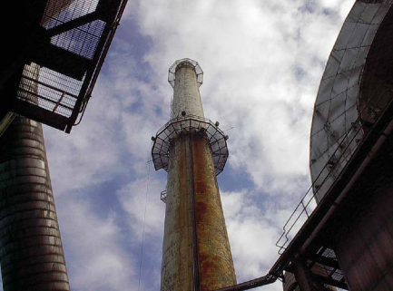

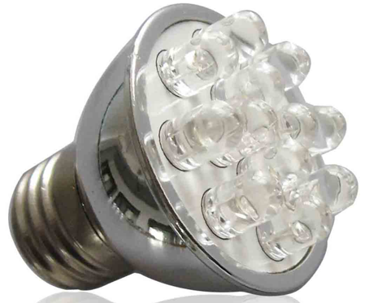
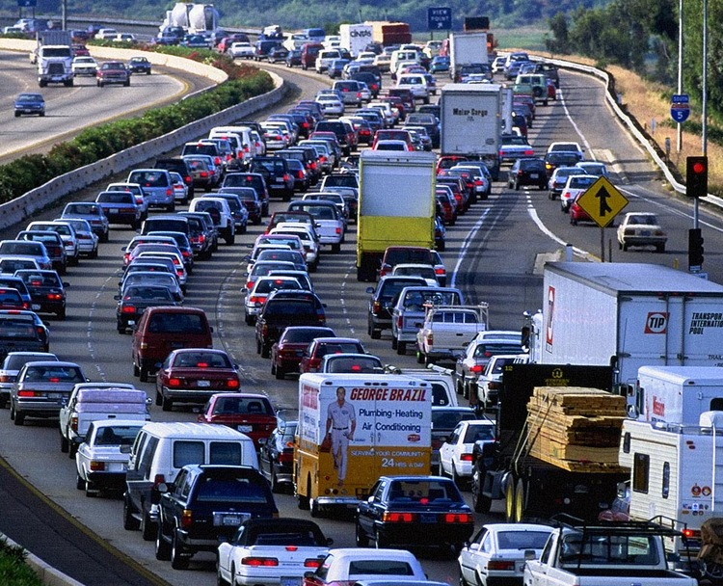
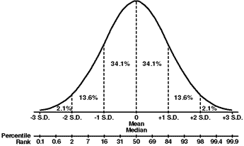
Measuring EE Emissions Reductions: RAP’s “Mobile Source Analogy”
Air Quality Measure
Air Quality Measure
Air Quality Measure
Notes:
EPA incorporates vehicles into SIPs routinely
Vehicles and EE both:
Have millions of discrete “installations”
Face similar issues – baseline, technology penetration, degree of use once installed, how used, persistence/degradation, etc.
Emissions can be reliably quantified via statistical sampling and analysis
Why not apply the same approach to both?

Slide 11
Tools Available to Assess Policy Options, Criteria Pollutant and GHG Emissions
EPA’s AVERT
EPA state specific 111(d) emissions obligation
Synapse 111(d) tool
MJ Bradley 111(d) tool
RAP/EFG EE power plant
WECC modeling
Notes:
Details of these tools are provided in the “additional slides” section of this presentation

Slide 12
Improved Air Quality
Is Just Part of EE/RE
Replace or defer construction of fossil-fueled units with EE/RE
Goal is develop a plan that maintains and improves reliability (energy, capacity and ancillary services)
Affordability is essential
Co-benefits: multi-pollutant, water, land, energy, public health, cost
Traditional control measures can increase CO₂ emissions (i.e., SCR and FGD for NO_{X} and SO₂ controls)

Slide 13
“Scale-It-Up” – Libraries of EE/AQ Data
Sources: Northwest Regional Technical Forum; Wisconsin Focus on Energy
Notes:
- Need “libraries” of EE measures’ performance data for regulators to “build” EE/AQ portfolios to meet air quality (AQ) requirements.

Slide 14
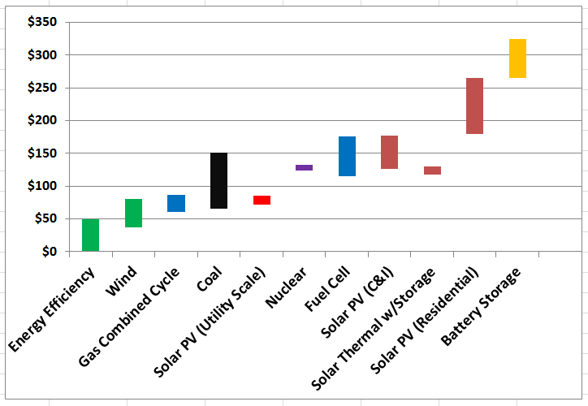
EE/RE Compete with Fossil Plants Today
(unsubsidized data shown below)
Notes:
Source: Lazard 2014 & Lazar 2014
Jim Lazar email, 9/22/14 re Lazard’s LCOE – Version 8 (2014):
I took the ranges they show (not the point estimates of 2017 cost), and entered the data into the spreadsheet I used to create a graphic for last year's data (which I had used last week in the NASUCA webinar on Decoupling).
Here's the result:
I'll note that the C&I is now at grid-parity with high-cost utilities, but probably NOT if the utilities have demand charges. BUT, of course, these are the UNSUBSIDIZED figures from Lazard, so those C&I customers will get 30% federal plus some state incentives.
I like the fact that they have separated out utility-scale, C&I, and residential PV.

Slide 15
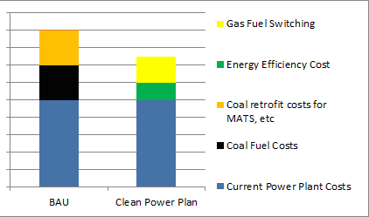
Push for Least-Cost Options
e.g., require utility IRP or other processes to compare:
  BAU scenarios: Don’t retire coal, don’t fuel-switch to gas, don’t accelerate efficiency, do incur coal retrofit costs, and with/ without CO2 adders; vs. …
  … 111(d) scenarios with gas and EE replacing coal fuel costs and coal retrofit costs.
  Hypothesis: the latter scenario will save money, even at low/no $/ton CO2
Notes:
- If consumer advocates don’t insist on least cost options, who will?

Slide 16
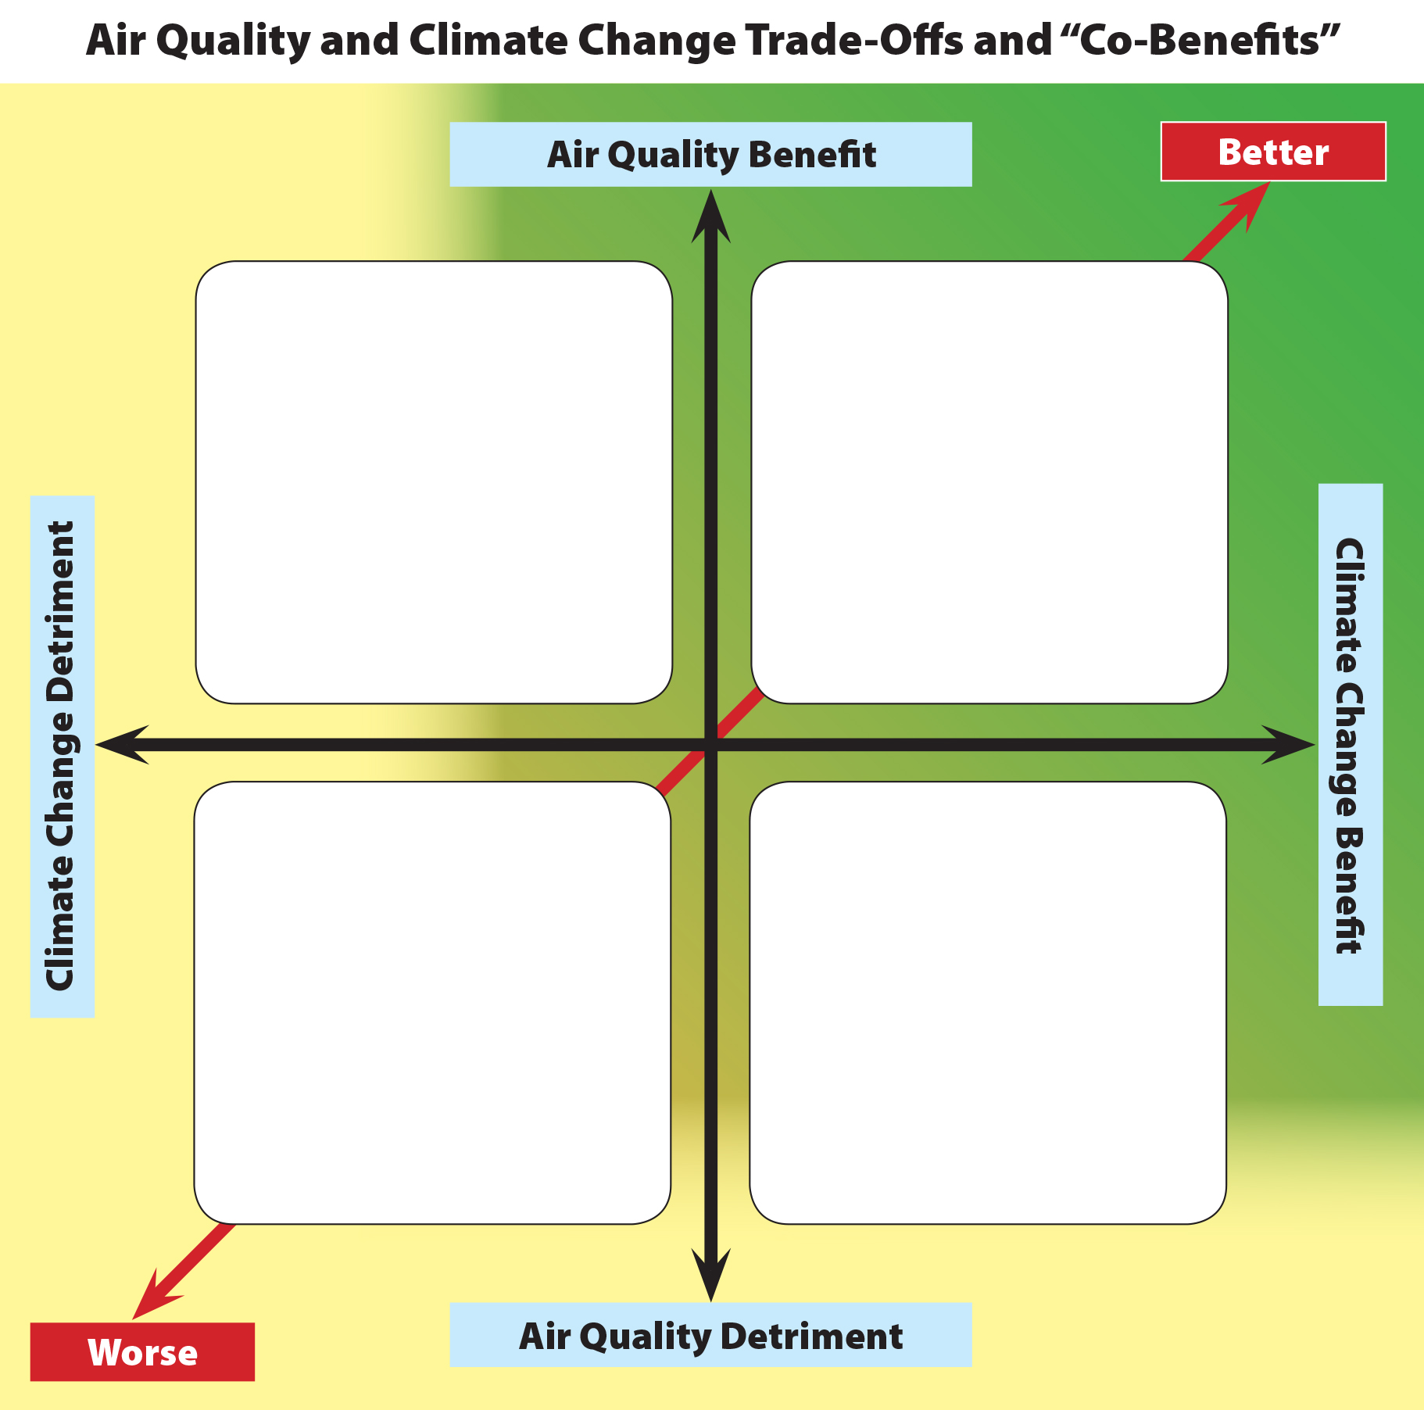
…And Try to Capture Co-Benefits
Good 111(d) choices can help air quality; good air quality choices can help 111(d) compliance
Ditto for increasing water concerns
Integrated multi-pollutant, multi-media approach can lower cost, risk (IMPEAQ)
Flue Gas
Desulfurization
(Scrubbers)
Three-Way Catalysts
(Petro)
Diesel Particulate
Filters
Energy Efficiency
Energy and Demand Resource Management
Combined Heat & Power
Wind, Solar, Tidal
Low- and Zero-Emission Vehicles
Carbon Capture & Storage
Uncontrolled
Fossil Fuel
Combustion
in Stationary and
Mobile Sources
Increase in
“Uncontrolled” Diesel
Biofuels
Biomass
Buying Emissions
Credits Overseas
Notes:
Adapted from: Julia Schmale and Erika von Schneidemesser, “Needs, Potentials and Challenges of Integrating Air Quality and Climate Change Policies”, Institute for Advanced Sustainability Studies Potsdam, Germany, May 2013.
Important, due to June 2014 decision by the Clean Air Scientific Advisory Committee (CASAC) to recommend that EPA reduce the ozone NAAQS to 60-70 ppb. SO2, NO2, PM, and regional haze issues too.
Also important due to increasing drought and water stresses affecting much of the U.S. Power plant de-rates and shutdowns have already occurred due to water issues; more are likely.
IMPEAQ = RAP’s Integrated Multi-pollutant Planning for Energy and Air Quality (see www.raponline.org/document/download/id/6440).

Slide 17
These Actions Are Essential
EE/RE in air quality plans must be “made easy” or the default will be to building only new gas plants
EM&V for EE is critical, but all states are not in the same place. “80/20 rule”: We want more EE everywhere.
  Message: “EE’s been around for decades, c’mon in the water’s fine”
Identify and exploit the Layer Cake of co-benefits that occur from EE
Engage with states and EPA regional offices
Ensure that new and revised air quality rules treat EE/RE as an equally effective means to achieve compliance.
Notes:
Recognize EM&V in NE, Pacific NW help enable precision, are deserving of replication by others

Slide 18
cjames@raponline.org
617-861-7684 (Pacific time)

Slide 19
Additional Slides- Part 1: Tools to Assess EE/RE
RAP/EFG EE Power Plant
EPA 111(d) state by state comparison
Synapse 111(d) tool
MJ Bradley 111(d) tool
EPA AVERT
WECC Modeling

Slide 20
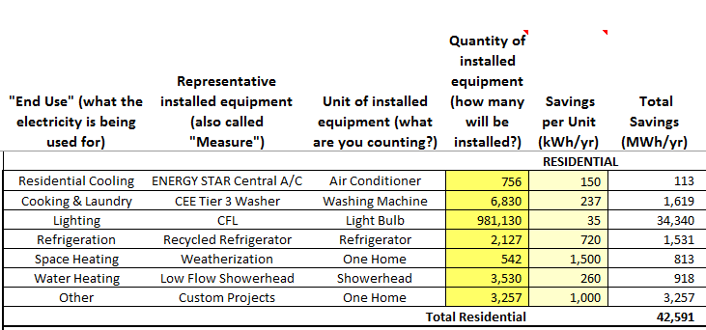
1.1 RAP/EFG Tool: Building an EE Power Plant
Notes:
This is an illustrative example based on the measures we had available to us. You can build your own portfolio based on specific measures, load shapes and savings data that are available to you.

Slide 21
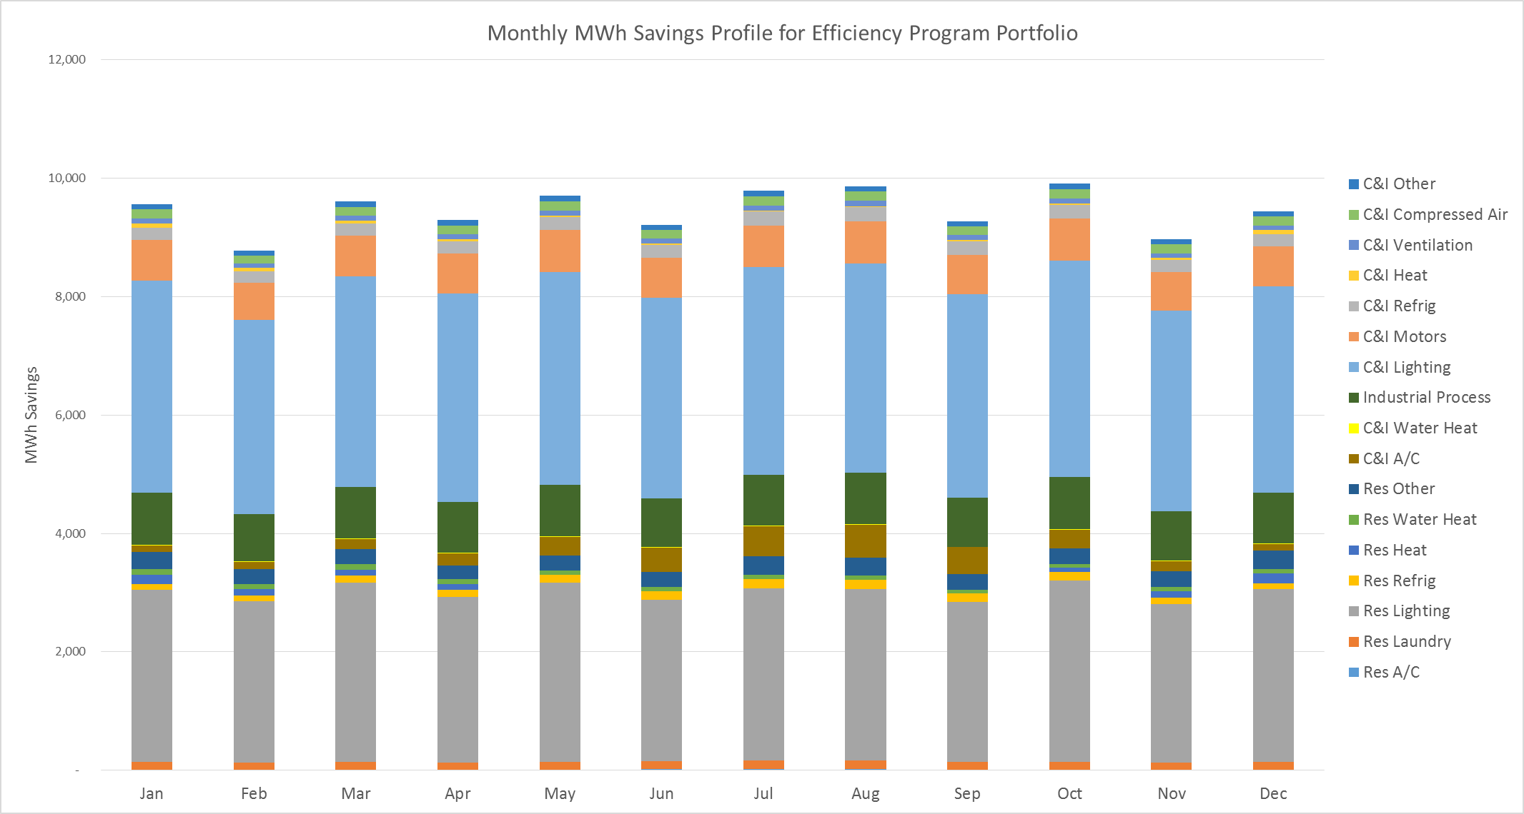
1.2 RAP/EFG “Build Your Own Power Plant”: Example EE Power Plant Output by Month
Notes:
that grouping of EE measures can be deployed that result in MWh savings curves that resemble the output of a physical power plant that would be dispatched to meet load (absent the EE).
Try the EE power plant tool out at: http://www.raponline.org/featured-work/cutting-through-the-fog-to-build-energy-efficiency

Slide 22
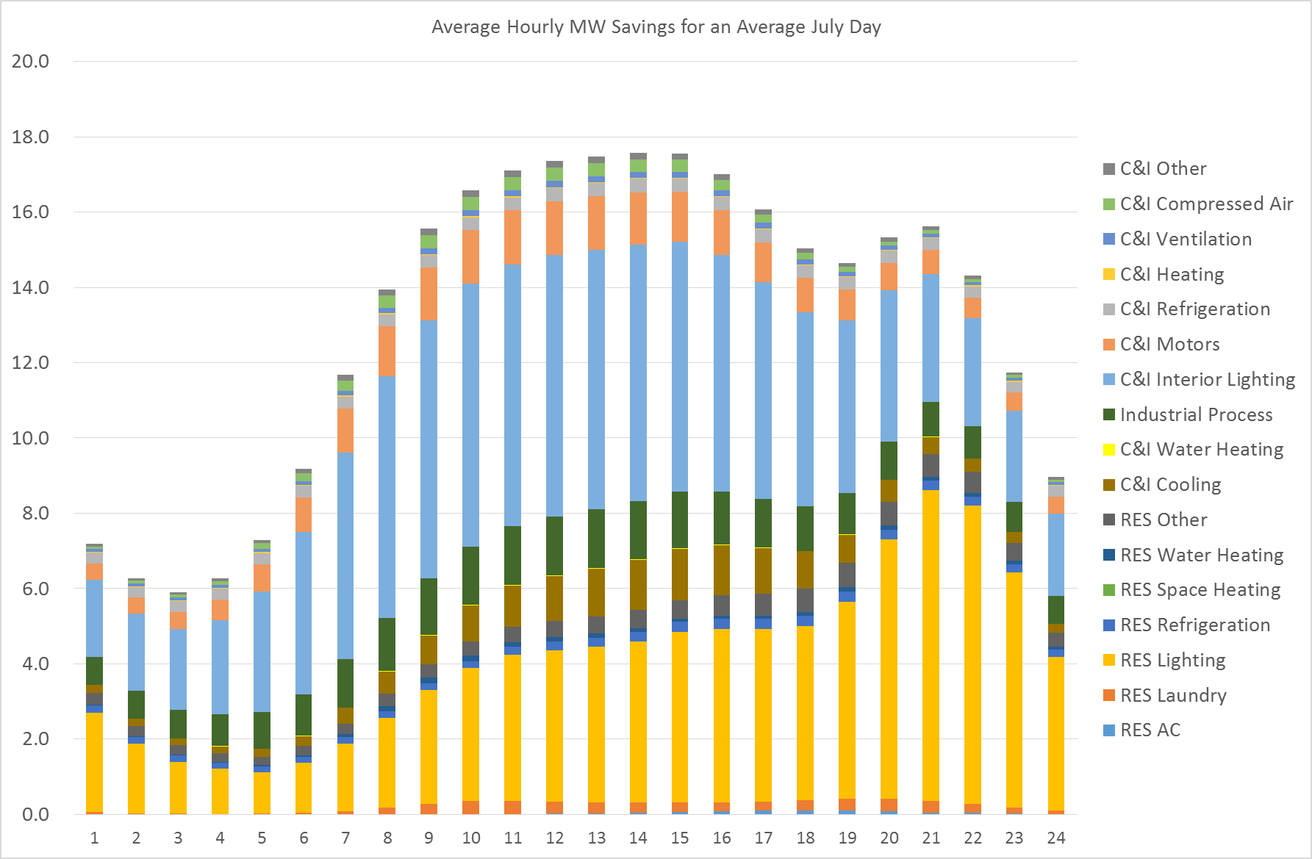
1.3 RAP/EFG Tool Example: EE Power Plant for a July Day
MWh Savings

Slide 23
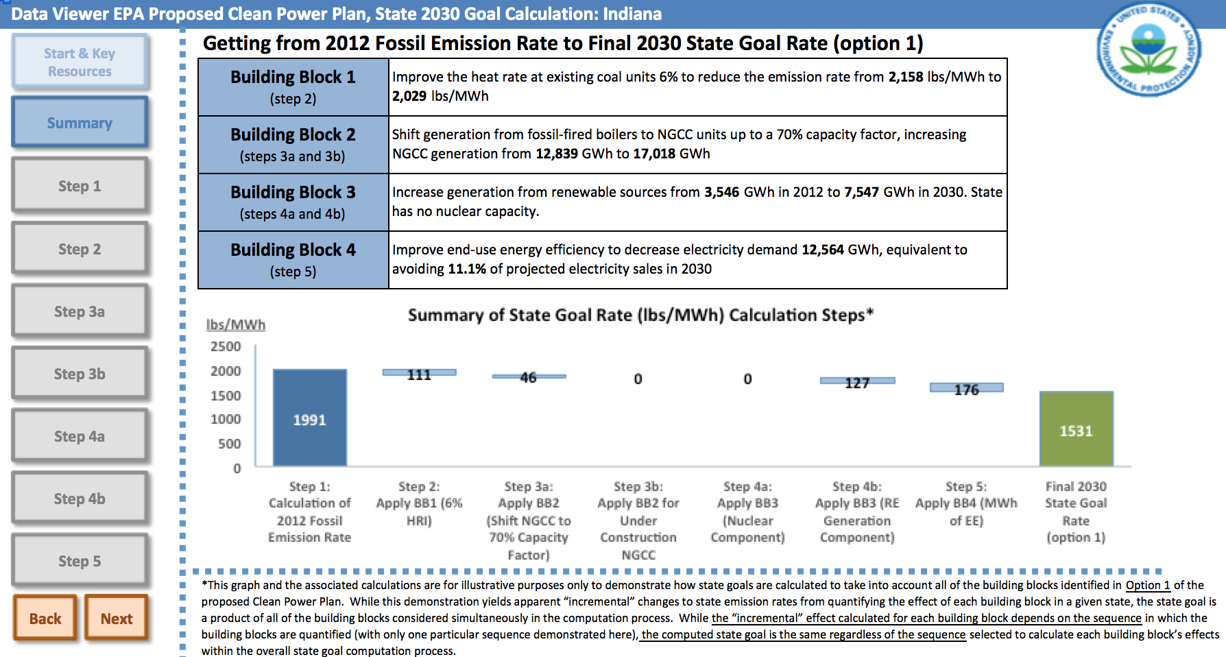
2.1 EPA’s 111(d) Rate Goal Visualizer
Source: http://www2.epa.gov/carbon-pollution-standards/clean-power-plan-proposed-rule-technical-documents
Notes:
Indiana shown, courtesy to Moderator Robb Mork.

Slide 24
2.2 Relative Contributions of Building Blocks by State
Note that
State requirements vary widely; and
Natural gas redispatch (orange) and RE (green) predominate
Source: NRDC
Notes:
Source: http://www.nrdc.org/air/pollution-standards/files/pollution-standards-epa-plan-summary.pdf
Predominance of orange (natural gas) and green (RE) evident visually.

Slide 25
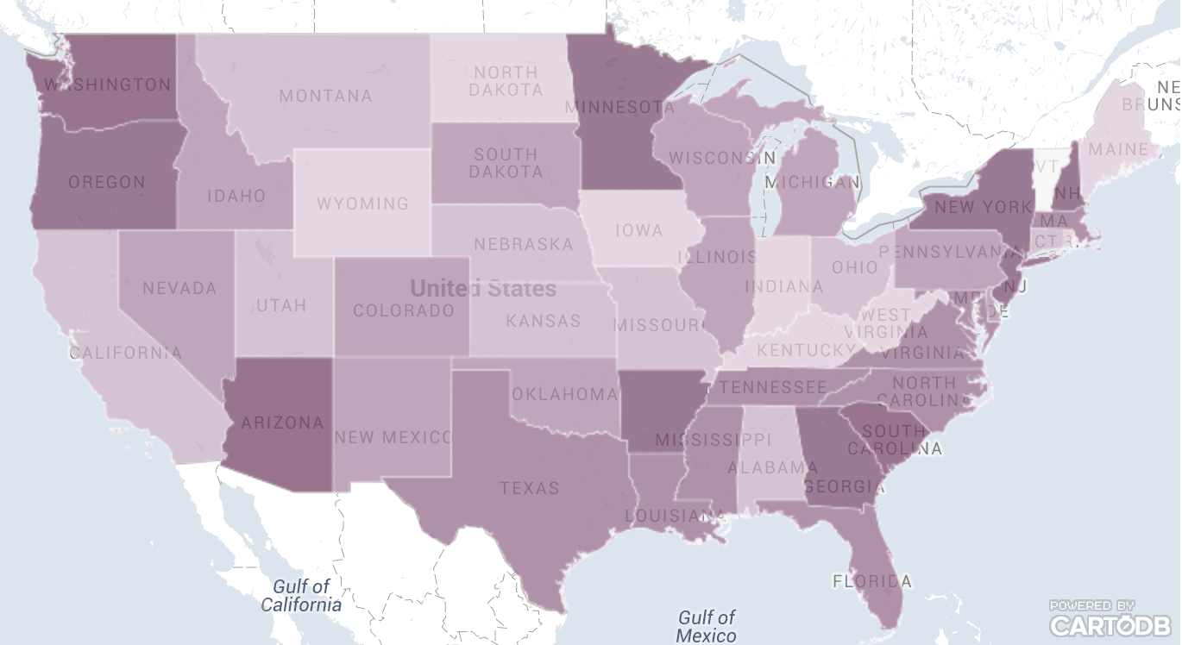
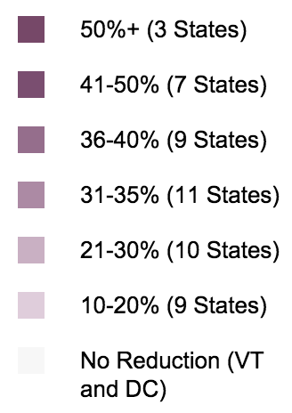
2.3 Reduction Requirements by State
Source: C2ES
Notes:
Source: http://www.c2es.org/federal/executive/epa/carbon-pollution-standards-map
Not a map of “usual suspects”!

Slide 26
3.1 Synapse 111(d) Tool
Permits state by state analysis of each of the four building blocks
Allows user to enter data on cost of EE/RE programs
Determines net costs and benefits

Slide 27
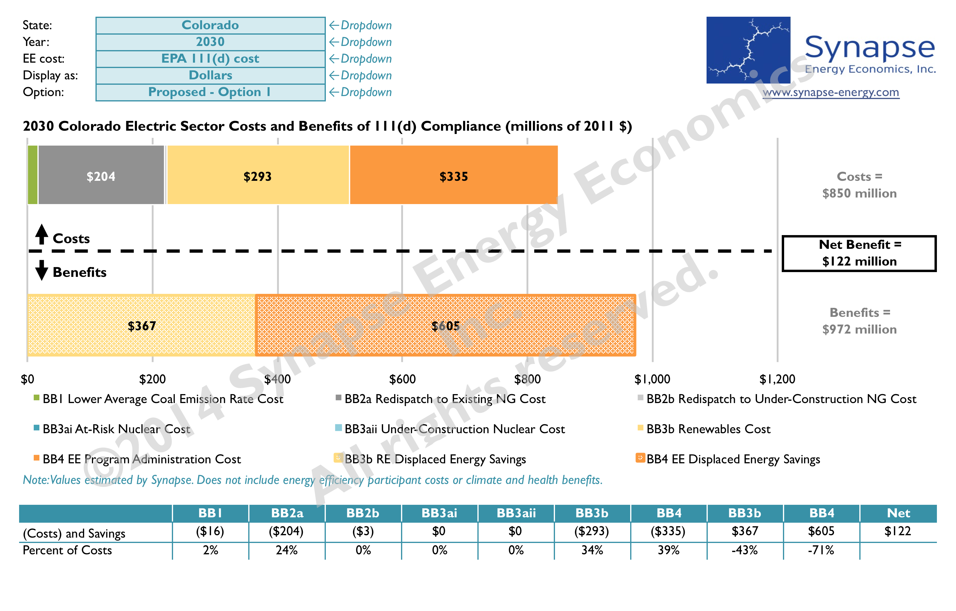
3.2 Synapse 111(d) Cost Estimate Tool Example
.
Notes:
Source: Synapse Energy Economics, 2014. Available for download via http://synapse-energy.com/tools/111d-cost-estimate-tool-states

Slide 28
4. 1 MJ Bradley 111(d) Tool
Also permits state specific evaluation. Compare up to three states simultaneously
Functionality: change assumptions about each of the four building blocks
Translate rate-based to mass-based CO2 emissions
Can add new NGCC builds, but is not a dispatch model
Notes:
Source: MJ Bradley and Associates, 2014

Slide 29
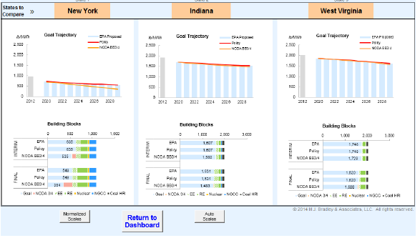
4.2 MJ Bradley 111(d) Tool Example Output
.
Notes:
Source: MJ Bradley and Associates, 2014
Download tool via http://www.mjbradley.com/sites/default/files/MJBA_CPP_Evaluation_Tool_v4.pdf

Slide 30
5.1 EPA AVoided Emissions and geneRaTion Tool (AVERT)
Developed for EPA by Synapse Energy Economics
Evaluate county, state and regional affects of EE/RE programs
Permits
  -Comparison of wind vs. solar installations
  -Emission impacts on high electric demand days
  -Multi-state benefits

Slide 31
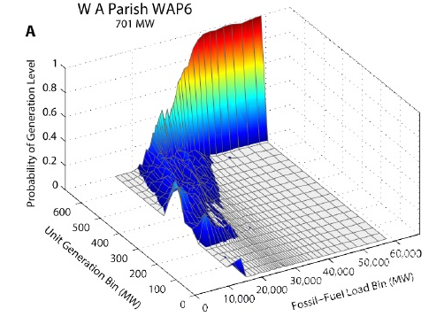
5.2 AVERT Output Example

Slide 32
6.1 WECC Modeling
September 19, 2014 report by WECC staff
  -adequate planning reserve margins today, no resource adequacy issues expected
  -BAU in many states will be significantly contribute to the GHG reductions needed under 111(d)

Slide 33
Additional Slides Part 2
EM&V
Co-Benefits to air, water, energy

Slide 34
EM&V Hurdles Remain
Notes:
- RAP has proposed several ways to help address the question of EM&V for emissions.

Slide 35
EE/RE Co-Benefits
Reduced criteria pollutants (ozone, PM)
Reduced toxics
Avoided line losses

Slide 36
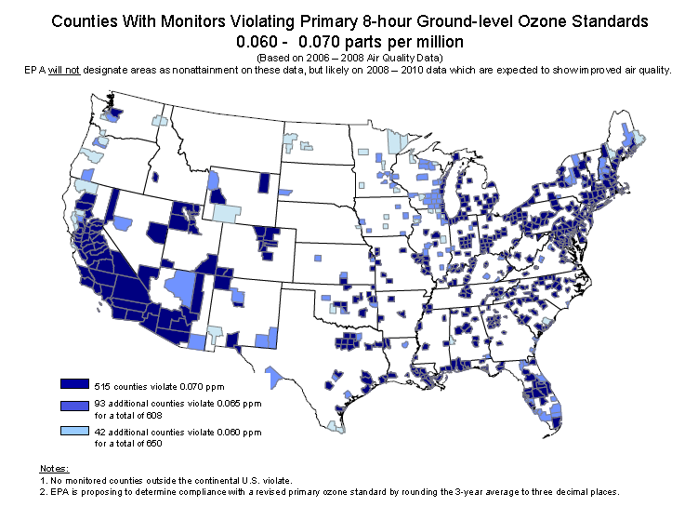
EPA is Currently Reviewing the Ozone NAAQS: What if It is Tightened?
Notes:
EPA is expected to announce its decision with respect to its review of science and public health data for ozone during 2015. In late 2014, EPA’s Clean Air Scientific Advisory Committee recommended a standard of 60-70 ppb.
This map shows the counties that would have been in nonattainment with an ozone standard of 70 ppb (darkest blue), if the determinations had been made based on 2006-2008 monitoring data. If the standard were lowered further to 65 ppb, the counties shown in dark blue and medium blue would have been in nonattainment, and if the standard was set at 60 ppb all the counties shown in all shades of blue would have been in nonattainment. This gives us an indication of where things might stand if EPA revises the ozone standard – with the caveat that the latest monitoring data would be used not the 2006-2008 data.
Source: EPA

Slide 37
Multiple Benefits of EE
Most analyses of EE are incomplete:
Some look only at avoided energy costs.
Many include production capacity costs, but not transmission or distribution capacity or line losses.
Few include other resource savings (water, gas, oil).
Very few try to quantity non-energy benefits.
Notes:
Source: RAP
DEFINITIONS as used here (from Dave Lamont, 7/18/12):
Energy is the weighted average avoided energy cost of the marginal units in each hour. It is the total energy dollar savings divided by the total MWh savings. So not exactly marginal cost, but a weighted average.
Capacity is the total capacity dollar savings divided by the total MWh savings. Capacity costs can be calculated differently in different market/non-market areas. The figure here is based on the $ savings attributed to capacity.
T&D capacity is the deferral value of T&D expansion avoided by efficiency – so essentially the carrying costs of any deferred investments, divided by the MWh savings. It does not include any T&D maintenance expenses. (See above.)
Line losses are marginal losses, used to gross up EE savings generally measured at the customer meter. This is for energy only, but a similar gross up is done for capacity, it is not broken out here.
Avoided reserves represents the savings in reserves (generally in the 10 – 15% range) resulting from lower peak demands. So if your load is 100 MW, adjusted for losses to 112 MW, you also avoid the purchase of an additional 15% of that amount to cover reserves (capacity in reserve to cover expected or unexpected outages). All capacity unit values are based on the carrying cost of a peaking unit, or a market value of capacity.
Externalities represent avoided stack emissions – based almost exclusively on a value of carbon which, from memory, was about $50/ton. (Vermont has since increased that value to $80/ton).
Other resources represents savings, as well as costs, to the consumer for savings from other resources. An efficient clothes washer will use less water, as well as less electricity. An efficient lighting system will save on air conditioning, but also increase winter heating costs. Does not include any utility power plant “other resources” savings.
O&M represents savings to the consumer from installation of the measures. So, a compact fluorescent will offset the purchase of several incandescent bulbs, as well as the electric savings. I am not sure how savings from installing a new gizmo effect this figure. That is, if you have an old lighting system and you replace it with a new one, there is some O&M savings because you will have to replace the old one at some point and the EE installation defers that cost.
Other fuel represents the net savings and costs of incremental fuel use resulting from EE measures. If you insulate a building to reduce AC use, you also save heating fuel.
Difficult-to-Quantify Non-Energy Benefits (DTQ NEB) includes a whole array of benefits that are derived from energy efficiency, some of which can be measured, others of which can not. This category includes things like improved comfort, wellness benefits (a la the New Zealand study Jim Lazar has been discussing), improved productivity, home value and others. In Vermont, they set this at 15% as a placeholder value.
Risk - The risk adjustment is a 10% adjustment that is actually applied to the cost of the EE measure for screening purposes. The cost of an EE measure is discounted (relative to traditional supply) to reflect the improved risk characteristics of EE – namely the ability to increase or decrease program activity to meet needs, the incremental nature of EE impacts, and the limited risk of stranded investment. (It's cost is lower as a result of this discounting, so it's value is higher.)

Slide 38
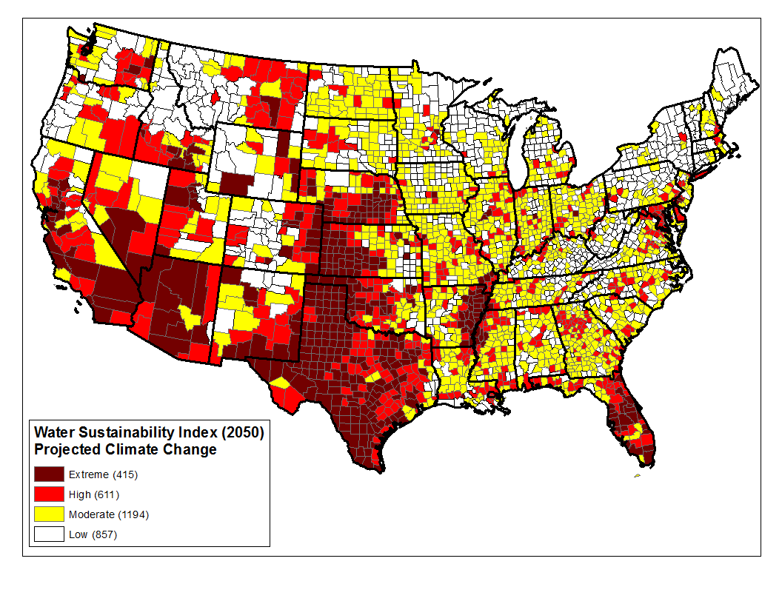
Water Constraints in West Offer Further Opportunities for EE/RE
Source: Roy, et al., 2010.
38
Notes:
Source: Paul Faeth, CNA.

Slide 39
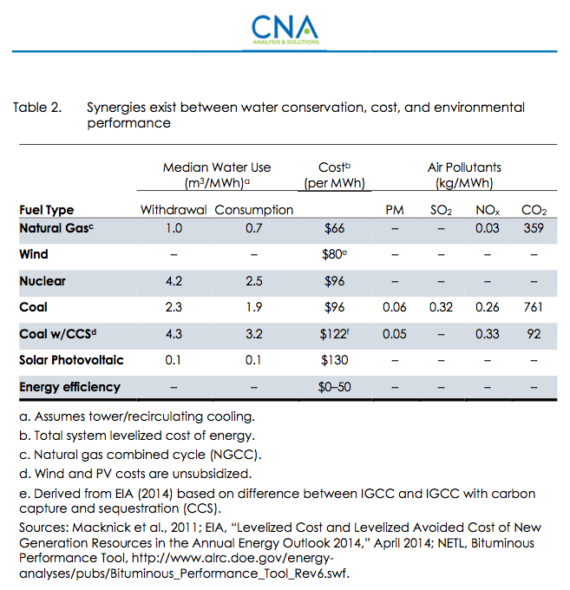
Water and 111(d) Synergies
Notes:
Source: Capturing Synergies Between Water Conservation and Carbon Dioxide Emissions in the Power Sector
Paul Faeth and Benjamin K. Sovacool July 2014. Page 9.

