Slide 1
Recent Western Interstate Energy Board work on renewable Integration
Western Clean Energy Advocates
January 8, 2015
Brian Parsons, Western Grid Group

Slide 2
Taking Advantage of Debbie Lew’s 2 months consulting to WIEB
Aimed at regulatory/energy office technical education
2 main products:
  Variable Energy Resources checklist – taxonomy of questions to raise in response to common issues http://westernenergyboard.org/ver-checklist/
  Western Interconnection Regional Advisory Body (WIRAB) 5 webinars on VER Integration topics http://westernenergyboard.org/wirab/webinars/
Debbie is now GE Energy staff and project-constrained
Notes:
Several utilities and regions have also broken wind penetration records in the past year. This chart shows installed wind capacity for major regional transmission organizations and independent system operators through 2012, and wind power’s share of total electricity demand achieved on particular days in some of these regions. For example, wind power provided:
--13% of California’s electricity in April 2013
--25% of the Midwest’s electricity in Nov. 2012
--30% of the Southwest Power Pool’s electricity in Dec. 2012
--35% of the total supply in Electricity Reliability Council of Texas (which leads the nation in installed wind capacity)
--Wind power also exceeded hydro generation in the pacific northwest for the first time in Nov. 2012
--And Xcel Energy, the nation’s leading utility provider of wind power, hit 57% in Colorado in April 2012 and 33% in the upper Midwest in Feb. 2013.

Slide 3
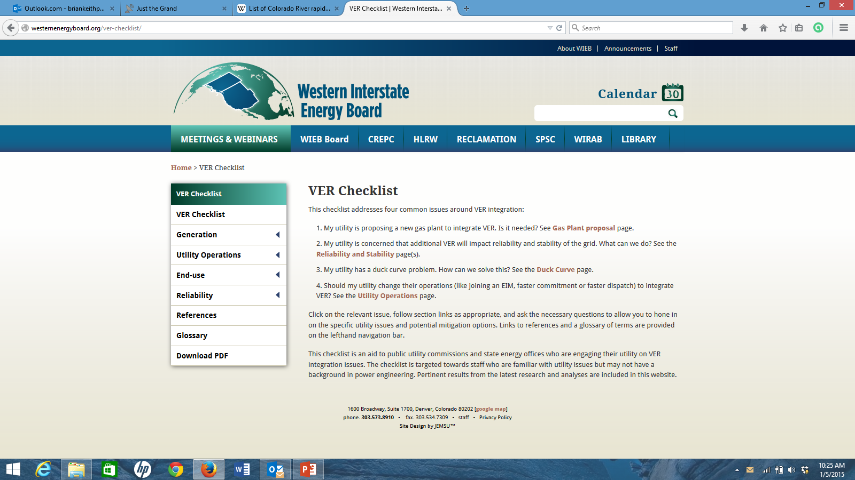
http://westernenergyboard.org/ver-checklist/
A final Version will be posted in Early January,
A short intro on how to use the checklist is in the works as well

Slide 4
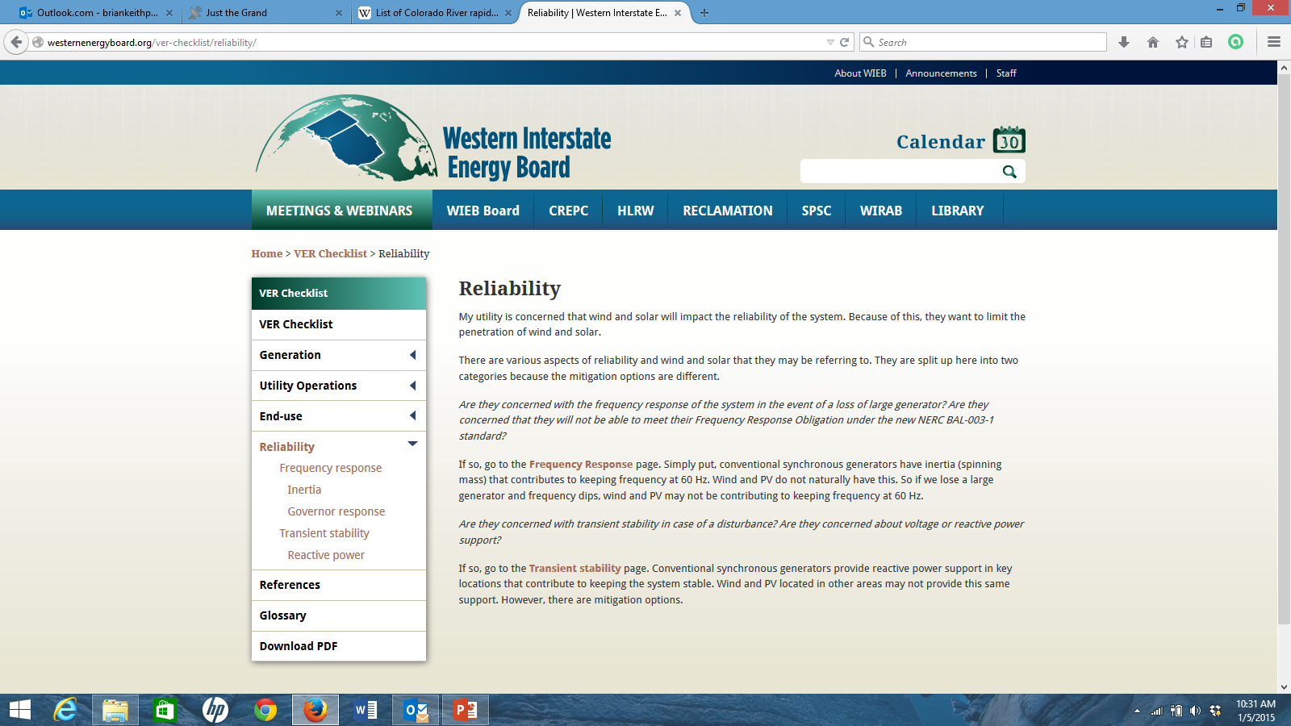

Slide 5
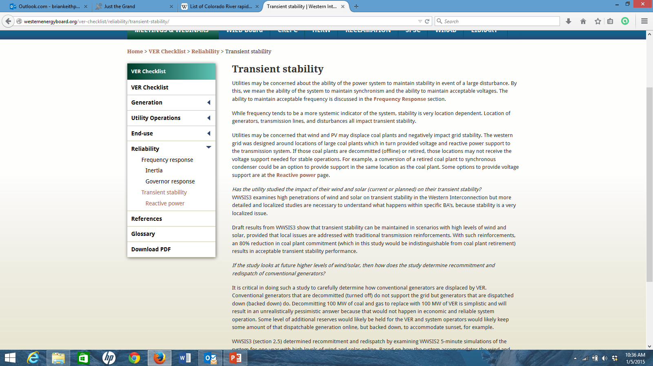

Slide 6
WIRAB Webinar Series
#1 Utility Operations - VER Reliability and Integration
  Basic utility operations: balancing, unit commitment and dispatch, reserves, and forecasting
#2 Ramping Issues and Solutions
  Duck curve, flexibility, markets
#3 Frequency Response
  Interconnect wide disturbance response: inertia, governor response, under frequency load shedding, advanced inverter control
#4 Transient Stability
  Rotor angle and power swing stability, reactive power, synchronous condensers and other mitigation
#5 Distributed Generation
  PV concerns, Germany, IEEE 1547, CA Smart Inverter Working Group
Notes:
#1 basic utility operations: balancing, unit commitment and dispatch, reserves, and forecasting
#2 Duck curve, flexibility, markets
#3 interconnect wide disturbance response: inertia, governor response, under frequency load shedding, advanced RE inverter control
#4 rotor angle and power swing stability, reactive power, synchronous condensers and other mitigation
#5 PV concerns, Germany, IEEE 1547, CA Smart Inverter Working Group

Slide 7
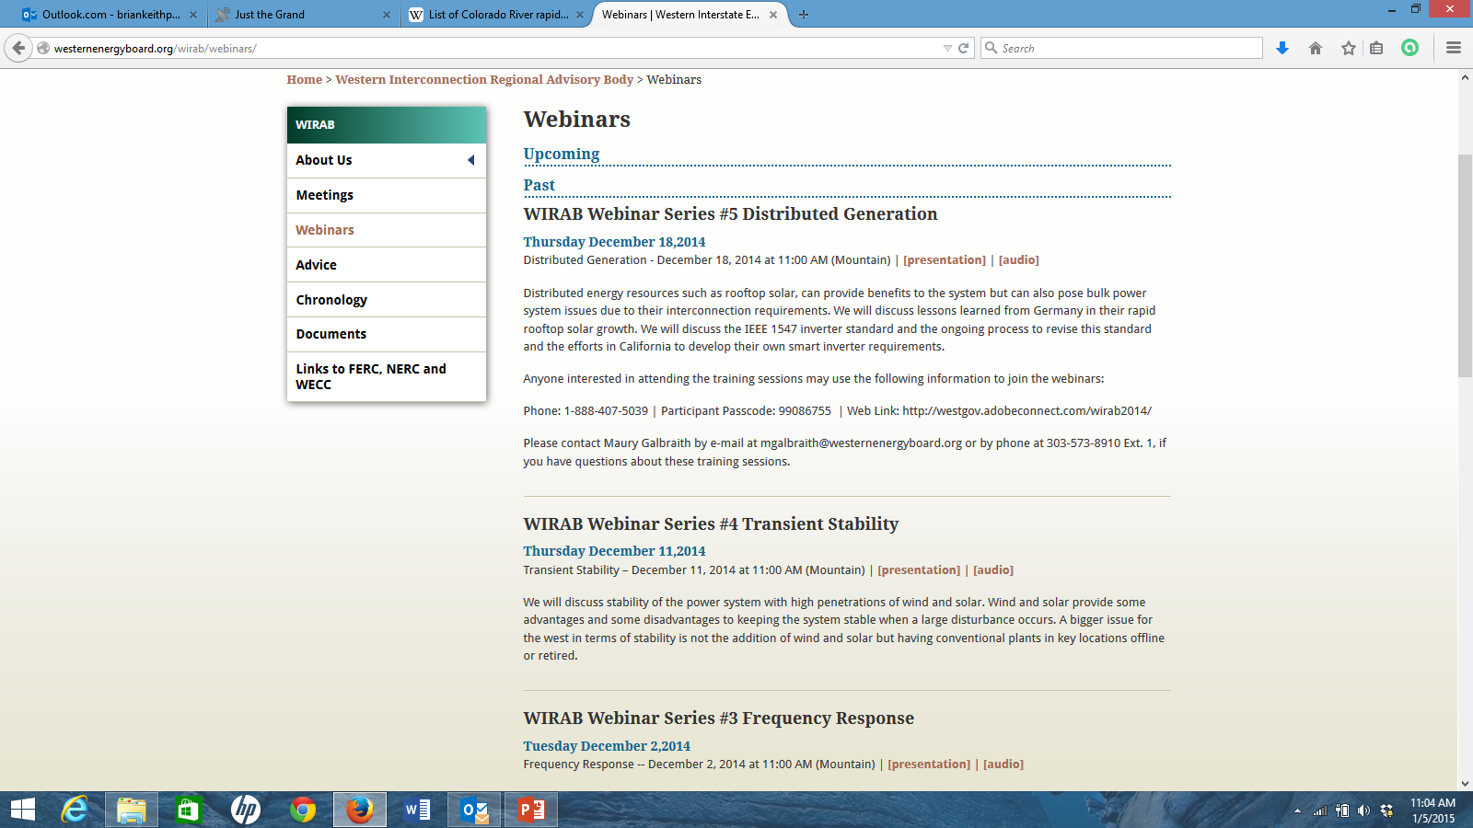
http://westernenergyboard.org/wirab/webinars
Excellent material for wide variety of stakeholder backgrounds
Condensed explanations sufficient to converse on utility specifics
Useful in dissecting reliability claims and road blocks
Idea for Advocate Engagement:
  “Book-club” approach
  Listen on own, or specific time scheduled?
  Follow-up with group discussion, Q&A

Slide 8
Additional items for WCEA
Integration discussions
WWSIS 3 final report is public, Nick Miller NERC IVGTF presentation is best distillation
  http://www.nrel.gov/docs/fy15osti/62906.pdf http://www.nerc.com/comm/Other/essntlrlbltysrvcstskfrcDL/Forms/AllItems.aspx
FERC CPP reliability, markets, and infrastructure technical conferences
  National Level February 19, Washington DC
  3 Regional conferences, including Denver, February 25

Slide 9
Additional items for WCEA
Integration discussions
2015 TEPPC Study Request
  Window Open until January 31, 2015
Upcoming UVIG meetings
  Forecasting Workshop, February 18-19 Denver, CO
  Spring Technical Workshop and Annual Meeting, April 21-23 Minneapolis, MN
  Fall Technical Workshop, October 13-15 San Diego, CA

