Slide 1
Humans and Change: how clean energy advocates can be effective in leading change
Amanda Ormond and Kate Maracas
Western Grid Group

Slide 2
Notes:
[Amanda]
Premise:
We are all advocates for a low-carbon, flexible, and reliable Western grid that can adapt to a rapidly changing future. That means we are change agents.
We (presenters) acknowledge that advocacy for change is what you (audience) do every day, and that you do it well. And we thought it would be instructive…and fun, to share some of our “change agent” experiences and perspectives with each other.

Slide 3
Walk a mile in my shoes…
Notes:
[Amanda] In order to succeed as change agents, we must recognize that we all walk in different shoes, and it’s important for all of us to understand, relate to, and empathize with how our listeners and audiences react, and what will (or won’t) resonate with them. And we must be aware that what we say and what they hear are often not the same things

Slide 4
“Every radical adjustment is a crisis in self-esteem: we undergo a test, we have to prove ourselves. It takes inordinate self-confidence to face drastic change without inner trembling.”
Eric Hoffer,
The Ordeal of Change
Notes:
[Amanda] Dealing with change:
We have many different audiences for the changes we advocate. And generally, people react to change in many different ways.
But even for those who easily embrace change, the process of change requires strong contemplation.

Slide 5
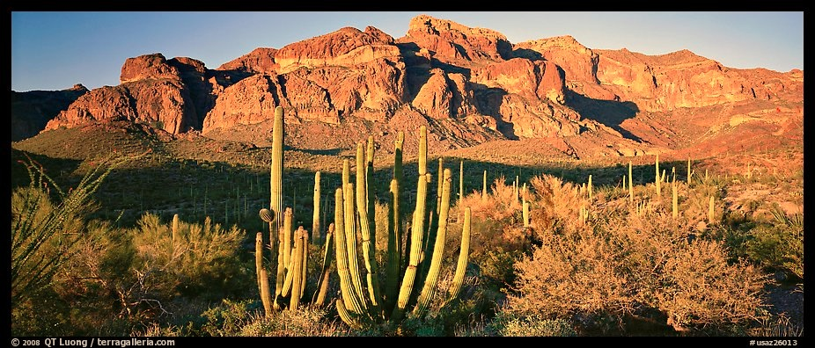
The Harvard Business Review Press postulates that when people are confronted with change:
20% will support the change at the beginning
50% will stay on the fence
30% will oppose the change
Notes:
[Amanda] So, where do we start?
…by remembering where our listeners are starting from.

Slide 6
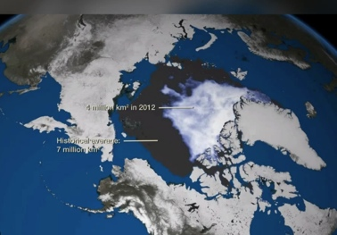
Notes:
[Kate} The changes we care about:
But some changes that we advocate are even more polarized than the 20/50/30 split that Amanda just mentioned. Climate change is one of those issues – maybe that’s because we’ve been talking about it for more than three decades. We advocates care deeply about climate change. And that means significant changes in the global energy sector. Our mission is to achieve a low carbon, modern, and reliable grid. HERE IS THE SIMPLE STORY WE TELL
We care about climate because of land conservation, clean air, human health effects and other externalities, protection of wildlife and habitat, and our descendants’ future. And we know that reduction of GHG emissions in the energy sector has the most efficacy of any possible human efforts to curb climate change impacts. And to most (if not all) of us in this room, it’s very real and very definitely caused by anthropogenic (big word for “human-caused”) activities. To many of us, it’s so straightforward.
This slide shows the dramatic loss of Arctic sea ice extent – or area, from 1979 to 2012. A loss of 3 million km2, or 43% in 33 years. The sea ice extent goes up in the winter and down in the summer, and this slide represents the annual summer minima during that 1979 – 2012 period.

Slide 7
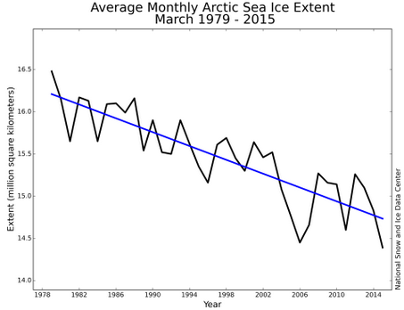
Notes:
[Kate] Here you can see the loss of ice graphically, up to 2015. In addition to losing sea ice extent, we’re also losing vast amounts of perennial ice – that which is 9 years or older. That means we’re losing significant volumes of ice as well as area. I know we’re not looking at something on a geological time scale here, but I can assure you there are backcast and forecast data sets that do consider broad time scales, and they show strong correlation between these kinds of trends and modern industrialization.

Slide 8
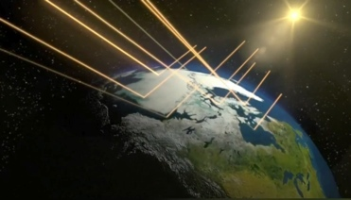
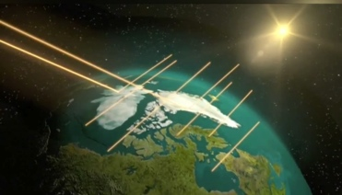
Historically, 90% reflection.
Now, 90% absorption.
Notes:
[Kate] So, when we really look at facts about climate change, we see that the loss of that polar ice causes increased absorption of the sun’s thermal energy, because the white, reflective ice is replaced by dark sea water. The physics of light absorption sets up a natural feedback loop, which accelerates the problem. We gearhead engineers call it hysteresis.

Slide 9
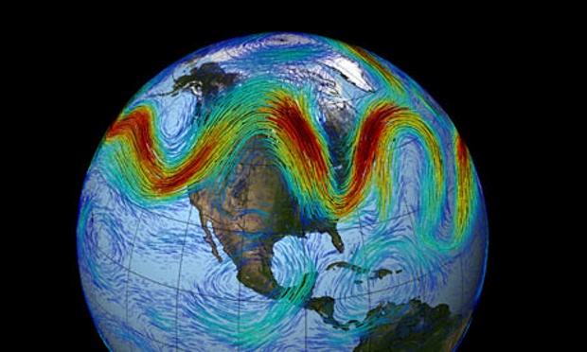
Notes:
[Kate] And that loss of ice also causes the temperature differential between the arctic and equatorial regions of the earth to decline. It’s that differential that has historically driven the Jetstream (“trade winds”) in a straight west-to-east pattern. But the concentration of GHGs has effectively taken our foot off the gas pedal off the Jetstream, causing extreme weather patterns. Those straight, predictable wind patterns are now warped and stalled, and account for the unusually warm winters here in the Northwest and the arctic blasts that hammer the east coast. But overall the mean temperature increases on an annual global basis. Makes perfect sense to us, right?

Slide 10
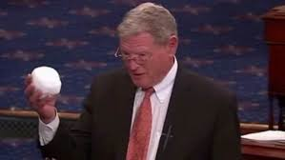
Notes:
[Kate]
For others, not so much. Many of our listeners hear the messages about climate science differently than we do. THEY HAVE A VERY DIFFERENT STORY TO TELL, USING THE SAME FACTS AVAILABLE TO US.

Slide 11
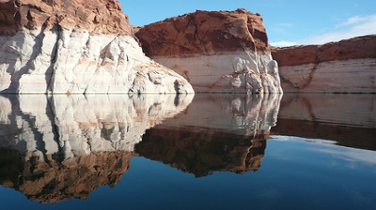
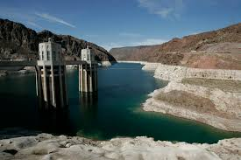
Image of Amanda’s AZ dam example here.
Notes:
[Amanda]
Everybody listens to WIFM (what’s-in-it-for-me) radio. It’s vital that we touch people’s emotions, not just their logic –almost everyone has a personal example that hits home (mom in Florida, or relatives on top of the Marcellus shale oil reserves.)
While we are policy nerds or energy geeks we need to understand that for climate change – something that is hard for people to perceive – we can connect with them if we can connect to their emotions about a place, a person or even a thing.

Slide 12
Transmission Planning is
SWAT RTO VGS
RMR IR FERC
ATC LSE OATT
ACE TAS ROD
BTA NTTG ISO TEPPC NOS EHV
OASIS CPCN ESS WECC
Alphabet Soup
Notes:
[Amanda]
Because we’re so wonky and we delve into so many things – we need to be clear not only about our asks and our messages but how those asks are being perceived and if we are hitting people’s “hot buttons”.

Slide 13
Notes:
[Kate] Here’s ANOTHER example that hit close to home for a personal friend of mine. He used to be slightly skeptical about climate change, and didn’t think humans could do much about it.
He’s also an avid hiker, and once the Paradise fire struck in the Olympic Mountains, his favorite Queets River trailhead was closed. And it won’t be the same again anytime soon. My friend now takes climate change very seriously.
By the way, in a normal year, the Olympic National Park is the wettest place in the continental U.S., with an annual 150 inches of rainfall.

Slide 14
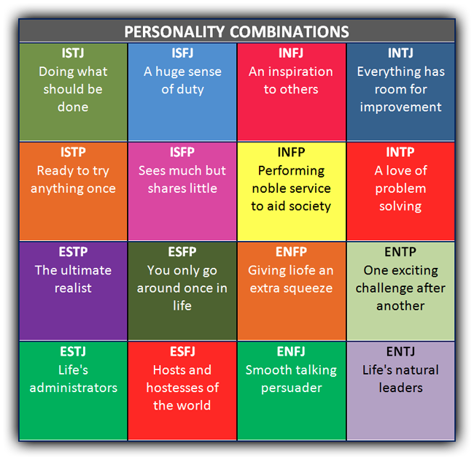
Notes:
[Kate]
In addition to touching emotions, we have to recognize that the many stakeholders we deal with also have different personality traits, different ways of reasoning, and therefore different ways of responding to change.

Slide 15
Notes:
[Kate]
Some of our responses to change are really about how we are measured – and how we are both rewarded and penalized.
So, how can we present our messages in a way that doesn’t polarize the issues?

Slide 16
Notes:
[Amanda]
Accomplishing our mission will take time.
First, we have to realize that we’re in this for the long haul – this requires developing trusted long term relationships.
It is worth our time to build relationships.

Slide 17
Notes:
[Amanda]
To create strong relationships, we need to be the honest broker
Tell our listeners both the good and the bad, including what detractors will say
That way, we get to frame the negative that they will inevitably hear.
They will hear it from us first.

Slide 18
reliability?
stability?
clean air?
affordability?
diminishing water supplies?
resource diversity?
Notes:
Amanda]
We concentrate on clean energy as a solution to climate change. So how do we communicate that message in a way that fosters relationship-building?
First, identify a place of common ground
What does the person care about? Do background research or ask them directly.
Do they care about water, affordability, air pollution, land use etc.?
Connect our issue to theirs.
How does clean energy help them solve their issue?
Clean energy is price stable which mitigates energy price fluctuations that hit low income hard.
What can you agree on?
There is increasing pressure on limited water supplies.
Price stability is good for all customers.
Diversification of energy sources creates resiliency.
Rapid change is rapidly occurring which creates opportunities and challenges.

Slide 19
Notes:
[Amanda]
When we advocate any change from the status quo, we are aiming at solving some sort of problem
People who understand and experience problems don’t have to be educated or informed
If we understand a problem and the people we work with don’t, we are likely to set up a polarity (us and them)
If everyone understands the problem, it will get resolved faster with more collaboration
Solving problems involves everyone in the solution
In short, we need to sell solutions, not problems

Slide 20
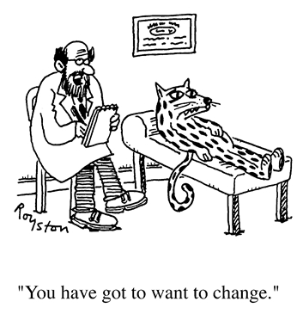
Notes:
[Kate]
But we can’t start by asking a leopard to change his or her spots…
Recall we said that 30% will oppose change?
A main driver for change may be the constraints of the organizations we work for.
First, we must learn what it is about the proposed change our listeners oppose
Next we must discover what changes to our proposed solutions would alleviate our listeners’ concerns
Then we can solve together

Slide 21
Now, some examples…
Notes:
[Amanda] - We thought it might be interesting to do a little role-playing to illustrate some examples of change proposals that we advocates have likely encountered.
[Kate] - And there are probably effective, and not-so effective techniques for advocating change.

Slide 22
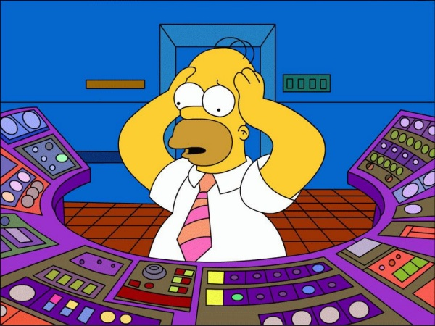
More new technology? Seriously?
Notes:
Amanda sets up Kate’s example of discussion with a control room operator.
(Kate’s script will go here.)

Slide 23
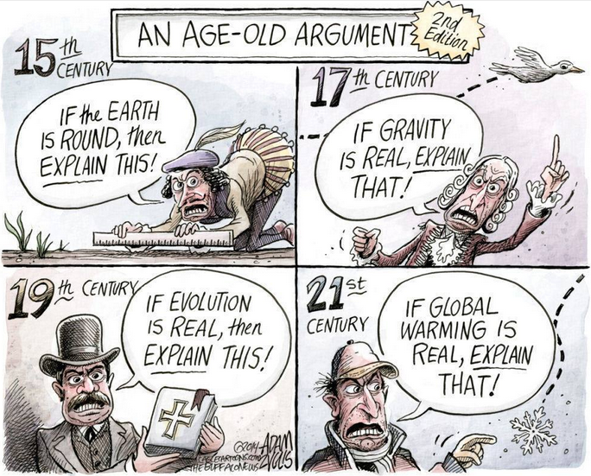
Notes:
Kate sets up Amanda’s role play.
(Amanda’s script will go here.)

Slide 24
Our Takeaways
Recognize that for all of us, the process of change is difficult, requiring contemplation and time to absorb the change.
In order to succeed as change agents, we must be empathetic to the diversity of our audiences. How does what you propose affect them personally, in their job, or within their organization?
Remember that what we say isn’t always what others hear – look for misunderstanding.
We must communicate our messages in a way that doesn’t set up polarity. Find common ground with our audiences and sell solutions, not problems
Work to discover what our listeners care about, and what changes to our proposed solutions would alleviate their concerns
We can solve climate change faster if we can solve it together.

