Slide 1
Thoughts on Order 1000 and Western Clean Energy Needs
Doug Larson
September 10, 2015

Slide 2
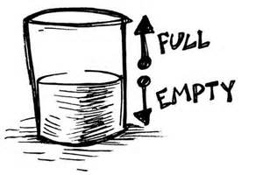
Perspectives
There are regional forums for planning discussions that can improve over time
Incremental improvements will be made as wind and solar expands
Grid not ready for a low GHG power system
Need to clear the path ahead of deployment of vast amounts of wind and solar
Planning - Order 1000 not helping power system get on IPCC track; WECC in retreat
Operations – Neither Regional Planning Groups nor WECC are doing enough on grid reliability with lots of wind and solar

Slide 3
Proposition: Order 1000 not helpful in the West
Western challenge is changing the operation of power system
Building new transmission is not the major challenge to clean energy
Order 1000 does not contribute solutions to Western challenges
Order missed the mark in the West (misplaced focus on transmission expansion, not system operation
Regional Planning Groups have adopted a minimal Order 1000 compliance mentality stifling innovation
Order and its implementation have undercut interconnection-wide transmission planning by WECC
What can be done?
Develop advocates position paper on what is needed
Message to FERC that Order 1000 is not meeting Western grid needs
Message to utility management that “check the box” mentality on Order 1000 compliance not in their interest
Message to RPGs and WECC on needed changes to make their work more relevant to Western needs
Think about future planning with PAC, CAISO (and maybe others) part of a regional ISO
Notes:
Study alternative futures with lots more VER, DER, DR
Focus study work on grid operations under these scenarios (not just what new wires can be justified)
Evaluate non-wires alternatives (including markets, new technologies, new operational practices

Slide 4
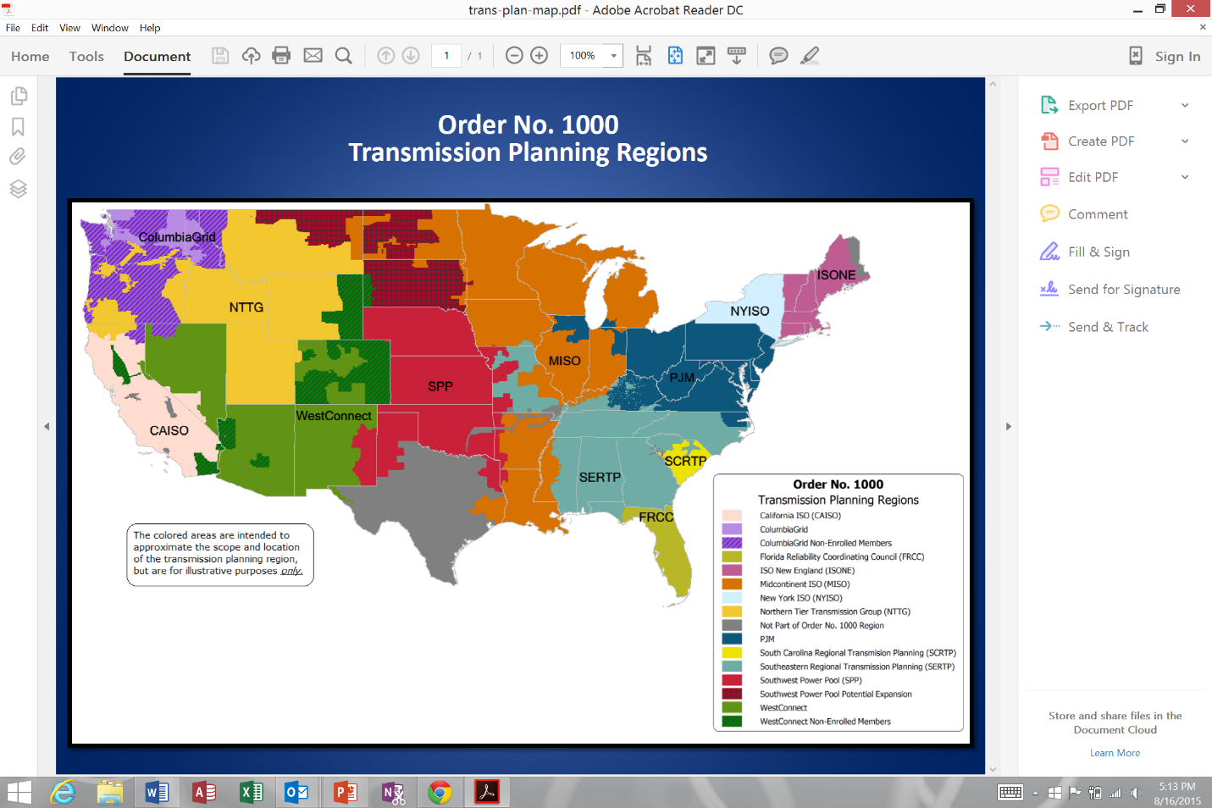
What we have
Regional Planning Groups (RPGs) have an Order 1000 compliance mentality
Pause (retreat?) of WECC in transmission planning precipitated by Order 1000, turf wars with RPGs, threats to WECC funding, loss of staff
Insufficient value added from RPG and WECC planning to identify what is needed for a low GHG future

Slide 5
What we need
Evaluation of wire needs and operational needs for futures that put us on the IPCC GHG glide path
Scenario analysis for achieving a low GHG power system
Quality reliability analysis of scenarios
Seamless planning among utilities and regions and across the Western Interconnection (including connections to Eastern Interconnection)
Data sharing among RPGs and with WECC (currently going the wrong way)
Analysis of inconsistencies among RPG plans

Slide 6
How we get what we need
Advocates’ paper explaining --
Why the West is failing in transmission planning (both at WECC and RPGs)
What the West needs
Message to utility management
Message to RPGs and WECC
Message to FERC

Slide 7
Develop advocates’ position paper
Use in discussions with FERC, RPGs, states and utilities
Outline Western challenges and what needs to be done to meet those challenges
Explain infirmaries of Order 1000 and its implementation in the West
Recommend reforms
Conduct evaluation of scenarios beyond those supplied by utilities
Do much more sophisticated reliability and grid operational analysis
Include robust analysis of non-wires alternatives
Adopt seamless coordination among RPGs and WECC
Improve data sharing
Request FERC conduct study of Order 1000 implementation in the West
Not a compliance audit
An evaluation of the relevance of RPG planning to needs of the Western grid
Re-evaluate RPG geography assuming a regional ISO (CAISO + PAC + others)

Slide 8
Message utility management
Compliance (check the box) mentality on regional planning is a failure of planning for the future and dooms each western utility to costly “go-it-alone” warfare on GHG emissions, instead of more lower cost regional solutions
Regional and Western Interconnection planning that doesn’t generate info of value to PUCs and the public should not be paid for by consumers
If RPG and WECC planning are to add value they must have involvement of utility resource planners and system operators, in additional to transmission planners

Slide 9
Message to RPGs and WECC
Compliance mentality adds little value for consumers; PUCs should deny cost recovery for planning that doesn’t add value
Need to study alternative futures with: low load growth; lots more wind and solar, Distributed Energy Resources, Demand Response; and more coal and gas retirements
Need seamless (across RPG boundaries) evaluation of wires and non-wires needs in futures that put us on the IPCC glide path
Need to focus more study work on grid operations (not just what new wires can or cannot be justified); stop focusing on how to block mandatory cost allocation (because it won’t happen anyway outside of the CAISO)
Need major upgrade to RPG and WECC analytical skills
Need collaborative process with DOE/labs to build RPG and WECC analytical skills
This will require participation by more than company transmission planners; need company resource planners and operations experts

Slide 10
Message to FERC
Order 1000 does not address major grid challenge in the West
Western RPGs have adopted a “compliance mentality”; innovation is stifled
Interregional coordination among RPGs is a step backward from interconnection-wide planning we had with WECC TEPPC
Cost allocation won’t be used (Swiss cheese of public power/IOUs; utilities willing to build transmission without Order 1000; insufficient demand for power carried by merchant projects to justify construction)
Data sharing not happening (e.g., historical path flow data and near-term load forecast data are confidential)
Quality of RPG analysis of reliability and analysis non-wires alternatives is not adequate
FERC needs to focus a spotlight on Order 1000 implementation in the West

Slide 11
Supplemental slides

Slide 12
Order 1000 changed little in the West
Order 1000 requirements | WestConnect | Columbia Grid | NTTG | CAISO
Participate in regional planning process | Utilities did this prior to Order 1000
Consider public policy needs | RPG planning is based on utility transmission and resource plans No focus on high renewables futures Little focus on grid operation |  |  | No change; ISO already based planning CPUC Resource Adequacy requirement and CPUC resource procurement assumptions
Coordinate planning with adjacent RPG | Minimal coordination under Order 1000 (compliance mentality- don’t do anything not needed to meet minimum requirements) Only difference from pre-Order 1000 planning coordination is more visibility of the communication among RPGs Role of interconnection-wide planning by WECC marginalized by RPGs
Cost allocation | In practice, there will be no mandatory cost allocation (outside of existing CAISO tariff) because of public power/IOU Swiss cheese No historical reluctance of utilities to build transmission
Eliminate federal first right of refusal | Not important because state ROFR still intact and utilities have been willing to build transmission

Slide 14
Columbia Grid: BPA dominated; only 2 IOUs
Cost allocation (outside of CAISO) won’t happen in the West
NTTG: No contiguous IOU territory if/when PAC moves to ISO
WestConnect: Swiss cheese of IOUs

