Slide 1
The Clean Power Plan:
Tools and strategies to address Reliability
- Reliability concerns are Broadly Real, but are often a red herring
- Directive to states to consider reliability is non-specific
Guiding Questions:
How can Advocates support accurate reliability assessment of compliance options?
What mitigation measures should be considered when specific reliability concerns are raised or identified?
Have Specific analyses been performed? What reliability standards are being evaluated?

Slide 2
Key Elements of Reliability
Account for Uncertainty with Different Reserve Margins
and Ancillary Services
Element #1: Planning/Resource Adequacy
  Load growth uncertainty
  Energy efficiency and Demand response load modifications
  Capacity credit of wind/solar
  Unit outage rates
  CPP related concerns seem more focused on
  development risk and contractual uncertainty

Slide 3
Key Elements of Reliability
Element #2 Normal Operations and Load Balancing
  Unit Commitment, Economic Dispatch, Regulation with Automatic Generation Control
  Security Constrained: accounts for transmission limits and contingency needs
  Time sequential Production Cost Minimization determines commitment, dispatch, and regulation merit order

Slide 4
Key Elements of Reliability
Element #3: Disturbance Response
  Contingency loss (unexpected, catastrophic) of large transmission line or generator (n-1)
  Transient Stability and Frequency Response
  Protective settings prevent equipment damage, but cascading outages are possible
  Breakdown into these elements allows dissection of concerns,
  but in reality the elements overlap to produce a “reliable” grid

Slide 5
Many Challenges may be self-imposed by Historic Practice
The power system is made up of two critical systems
  Physical power system – generators, transmission…
  Institutional system, including markets, reliability rules, general operating practice
Integration should consider both, and solutions formulated accordingly
Power system operation, reliability, cost
Physical system
Market and institutional “filter”

Slide 6
Taking Advantage of Recent Western Interstate Energy Board work on Renewable Integration
Variable Energy Resources (VER) Integration Dashboard is aimed at regulatory/energy office technical education
2 main products:
  Variable Energy Resources checklist – taxonomy of questions to raise in response to common issues http://wiebver.org/ver-checklist/
  Western Interconnection Regional Advisory Body (WIRAB) 5 webinars on VER Integration topics, Nov-Dec 2014 http://westernenergyboard.org/wirab/webinars/
Notes:
Several utilities and regions have also broken wind penetration records in the past year. This chart shows installed wind capacity for major regional transmission organizations and independent system operators through 2012, and wind power’s share of total electricity demand achieved on particular days in some of these regions. For example, wind power provided:
--13% of California’s electricity in April 2013
--25% of the Midwest’s electricity in Nov. 2012
--30% of the Southwest Power Pool’s electricity in Dec. 2012
--35% of the total supply in Electricity Reliability Council of Texas (which leads the nation in installed wind capacity)
--Wind power also exceeded hydro generation in the pacific northwest for the first time in Nov. 2012
--And Xcel Energy, the nation’s leading utility provider of wind power, hit 57% in Colorado in April 2012 and 33% in the upper Midwest in Feb. 2013.

Slide 7
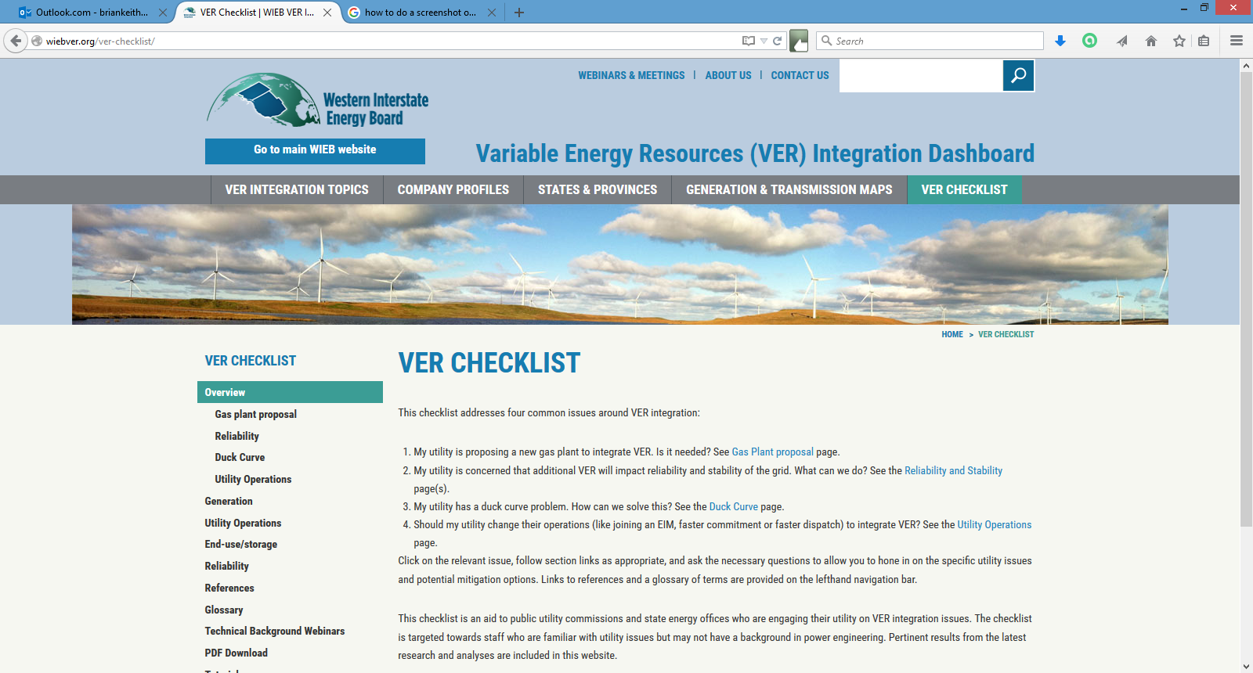

Slide 8
WIRAB Webinar Series
#1 Utility Operations - VER Reliability and Integration
  Basic utility operations: balancing, unit commitment and dispatch, reserves, and forecasting
#2 Ramping Issues and Solutions
  Duck curve, flexibility, markets
#3 Frequency Response
  Interconnect wide disturbance response: inertia, governor response, under frequency load shedding, advanced inverter control
#4 Transient Stability
  Rotor angle and power swing stability, reactive power, synchronous condensers and other mitigation
#5 Distributed Generation
  PV concerns, Germany, IEEE 1547, CA Smart Inverter Working Group
Notes:
#1 basic utility operations: balancing, unit commitment and dispatch, reserves, and forecasting
#2 Duck curve, flexibility, markets
#3 interconnect wide disturbance response: inertia, governor response, under frequency load shedding, advanced RE inverter control
#4 rotor angle and power swing stability, reactive power, synchronous condensers and other mitigation
#5 PV concerns, Germany, IEEE 1547, CA Smart Inverter Working Group

Slide 9
Coming Attractions
NREL/DOE Western Wind and Solar Integration Study, 3+
  Deep dive on “weak grid” issues for NE WECC, extreme situational analysis of disturbance response
California Low Carbon Grid Study
  50% carbon reduction operational study, shows how key regional cooperation is to CA goals, and changes needed to minimize RE curtailment
IEEE Power and Energy Magazine, Nov/Dec
  Focus on Wind and Solar Plan Integration on the Transmission System
Notes:
#1 basic utility operations: balancing, unit commitment and dispatch, reserves, and forecasting
#2 Duck curve, flexibility, markets
#3 interconnect wide disturbance response: inertia, governor response, under frequency load shedding, advanced RE inverter control
#4 rotor angle and power swing stability, reactive power, synchronous condensers and other mitigation
#5 PV concerns, Germany, IEEE 1547, CA Smart Inverter Working Group

Slide 10
Recent Additional Resources
Large Scale Solar Association, “Integrating Higher Levels of Variable Energy Resources in California”, June 15, 2015
Report by GE examines CA duck curve issues including those arising from import and self scheduling practices, including economic and reliability implications. Suggests mitigation options, including extracting more flexibility from the existing system, and alternative sources of ancillary services
Advanced Energy Economy Institute, “Integrating Renewable Energy into the Electricity Grid, Case studies showing how system operators are maintaining reliability”, June 2105
Report by The Brattle Group summarizes actions taken in ERCOT and by PSCo to accommodate larger penetrations of VER, including market design, transmission construction, advanced forecasting, advanced operations with existing resources, and improved RE technology and use of advanced grid services from inverter based generation and demand response.
AEEI also has several reports critiquing NERC’s initial CPP reliability review, and other reports on RE technology, and other CPP issues
NREL, “Review and Status of Wind Integration and Transmission in the United States: Key Issues and Lessons Learned”, March 2015
In support of the updated DOE Wind vision, this report summarizes the lessons learned from some of the most relevant and comprehensive wind integration studies conducted during the past several years, lessons from operating practices, especially as related to reserves, efficient operating practices, and wind power forecasting. It also describes the main industry organizations involved in wind integration and transmission, and discusses transmission expansion related to wind energy.
The Analysis Group, “Electric System Reliability and EPA’s Clean Power Plan” – series , “Tools and Practices”, Feb 2015, “The Case of PJM”, March 2015, “The Case of MISO”, June 2015
These reports push back against pessimistic reliability claims by looking at how existing standard industry reliability practices can accommodate CPP related changes, similar to past emissions regulation adaptations. Factors demonstrating that grid operators are well positioned to adapt to changes are discussed. PJM analysis of regional solutions, and an increased role for EE and RE are noteworthy.
Notes:
#1 basic utility operations: balancing, unit commitment and dispatch, reserves, and forecasting
#2 Duck curve, flexibility, markets
#3 interconnect wide disturbance response: inertia, governor response, under frequency load shedding, advanced RE inverter control
#4 rotor angle and power swing stability, reactive power, synchronous condensers and other mitigation
#5 PV concerns, Germany, IEEE 1547, CA Smart Inverter Working Group

Slide 11
Key Organizations
The Utility Variable-generation Integration Group
  Mission is to accelerate the development and application of good engineering and operational practices supporting the appropriate integration and reliable operation of variable generation on the electric power system. Best utility peer-to-peer forum. Get the right people from your utility and grid operator to participate!
IEA Task 25, Design and Operation of Power Systems with Large Amounts of Wind Power
  International Technical Collaboration to provide information to facilitate the highest economically feasible wind energy penetration within electricity power systems worldwide
And of course, all of “us” and our friends: reports, messaging, blogs
The Regulatory Assistance Project
America’s Power Plan (Energy Innovation)
NRDC and Sustainable FERC
AWEA

Slide 12
What Reliability Questions are being raised in your states and by Utilities?

Slide 13
Questions??
Brian Parsons
Western Grid Group
brian@westerngrid.net
(720) 360-6412

Slide 14
resource Adequacy in WECC
Methods and numeric are somewhat archaic, for example by the Reliability Assessment Working Group (RAWG) for TEPPC planning evaluations.
Required planning reserve margins vary with a range of 11-19.2% by region, and season (lowest: California in Summer, highest: NWPP in Summer)
Wind and Solar capacity value is fixed, rule of thumb values
  PV =60%
  Wind: 5% in NWPP, 16% in N. CA, 10% everywhere else
Site and Portfolio specific capacity credits can be evaluated with open-source NREL tool “Renewable Energy Probabilistic Resource Assessment tool (REPRA)” using multi-year historic meso-scale weather data

Slide 15
slides on operational issues

Slide 16
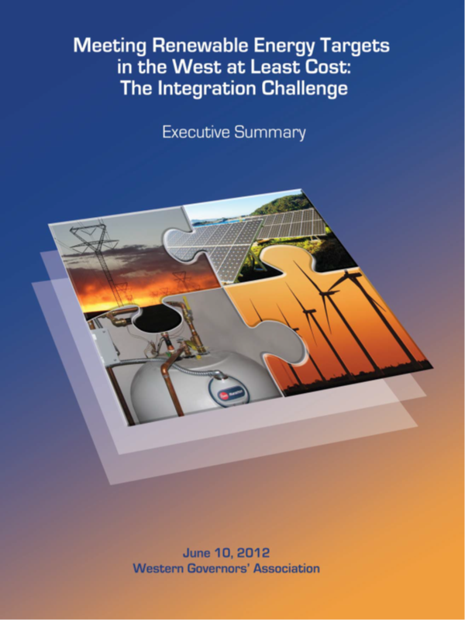
WGA Report: Pathway to a High
Renewable grid Future
  Builds on NREL Western Wind and Solar Integration Study conclusion: technically feasible, but requires a departure from BAU Operations
  Identifies barriers and institutional challenges, and possible regulatory actions

Slide 17
Key results from operational Integration Studies
A library of studies: 25%-33%-40%-50% annual electric from wind and solar
Economic, reliable operations are technically feasible
High value from:
  Regional grid cooperation
  Demand Response as source of reserves
  Incorporating wind and solar forecasts in grid operations
  Dynamic variability reserve to address solar
  Shorter unit-commit and dispatch windows
Reserves practices are not standardized, and overly conservative or outdated procedures are detrimental

Slide 18
Key results from operational Integration Studies
Transmission
  Limited wires expansion needed for 10-20%, if existing lines are better utilized
  Region-to-Region transmission expansion is necessary for higher 20-35% penetrations
Fossil cycling (ramping and start up)
  may add around $1/MWh of fossil (0.5%-2% of fuel savings)
  minor emissions impacts
Storage valuation is tricky
  better use of existing facilities, CSP, and thermal/ice are near-term, high value
  little near- to mid-term justification for advanced, new technology due to high cost

Slide 19
More Slides on Disturbance Response

Slide 20
Disturbance response - context
STUFF Happens! Plan for system stability and recovery
from loss of big generators or power lines,
WITHOUT DROPPING LOAD
NERC standards apply
  and continue to evolve, fines can be imposed for violation
  Regional Reliability Organizations generally align with ISO/RTO’s
  WECC/Peak bifurcation
Two Part Issue:
  Frequency Response
  Transient Stability

Slide 21
Disturbance Response
Frequency Response
  Interconnect-wide issue
  Contingency reserves large enough to make up for “n-1” WECC event is loss of 2 Palo Verde units (2750 MW)
  Worst case for RE – Light spring load, with lots of wind/solar
Transient Stability
  Sub-regional, local issues (LOCATION MATTERS!)
  WECC examples: Pacific DC Intertie 3100 MW outage, Broadview 500kV (Colstrip) fault and trip, Laramie River 345kV fault and trip
  Worst case for RE – High summer load, with heavy path loading

Slide 22
Key results from Disturbance response with Wind and Solar studies
only a few analyses to date, developing field of work
Disturbance Response appears adequate for 33-40% wind and solar and substantial coal displacement
  Use good, established planning and engineering practices, and
  Commercially available technology
Tripping of rooftop PV without fault ride-through can result in system collapse
(fix IEEE 1547 with CA Smart Inverter Stds. ??)
Can not expect system to work without additional resources
And system adaptations to new conditions

Slide 23
Disturbance response with Wind and Solar
WWSIS 3 findings
Attention to model parameters (control settings) is needed to validate against grid performance
Frequency response degrades, but remaining conventional generators keep nadir > 59.5 Hz
WECC-wide Frequency Response Obligation (FRO) meets NERC standards (~860 MW/0.1 Hz), but some BA’s may need resource sharing (allowable)
Location is most important for transient stability, not generator type
High power transfer cases require Remedial Action Schemes, with and without wind/solar
WECC 80% reduction in Coal commitment acceptable, 90% reduction necessitated addition of 3 synchronous condensers

Slide 24
Conventional solutions
Traditional transmission system reinforcements to address stability, voltage, and thermal problems include:
Transformers
Shunt capacitors
Series compensation
Static VAR compensators (SVC)
Static Compensators (STATCOM, including D-Var)
Local transmission lines

Slide 25
Additional solutions
Frequency responsive controls on synchronous Concentrating Solar Power (and Hydro) plants
Synchronous condensers
  New ($200/MVA)
  Conversions of retiring fossil plants ($40/MVA)
  Clutch option on new gas generators
Storage, and Demand Response

Slide 26
Additional solutions
Advanced controls on inverter-based generators
  Increased complexity, but may be “better” than synchronous capabilities
  Commercial options available, not generally requested or required (Wind in ERCOT and Quebec exceptions)
  Wind inertial option has no energy/opportunity cost
  Governor droop and AGC ramp-up are essentially curtailment, use sparingly
Market Design and Economic Optimization Issues?

Slide 27
Supplemental information/background slides

Slide 28
The North American Electric Reliability Corporation (NERC) is a not-for-profit, international regulatory authority whose mission is to assure the reliability of the bulk power system in North America. develops and enforces Reliability Standards; annually assesses seasonal and long‐term reliability; monitors the bulk power system through system awareness; educates, trains, and certifies industry personnel; subject to oversight by the Federal Energy Regulatory Commission and governmental authorities in Canada.

Slide 29
NERC definition of re
Can enable access to market by distributed generation and demand response
R. Zavadil, UVIG, 2014 Tucson, AZ

Slide 30
Operations and Balancing with high penetrations of wind and solar
Modeling Frameworks
    Power System Chronologic Production Cost Modeling
    Security-Constrained Unit Commitment and Economic Dispatch
    Key Issue: Renewable resource characterization
      capture geographic diversity
      correlation of weather and electric demand

Slide 31
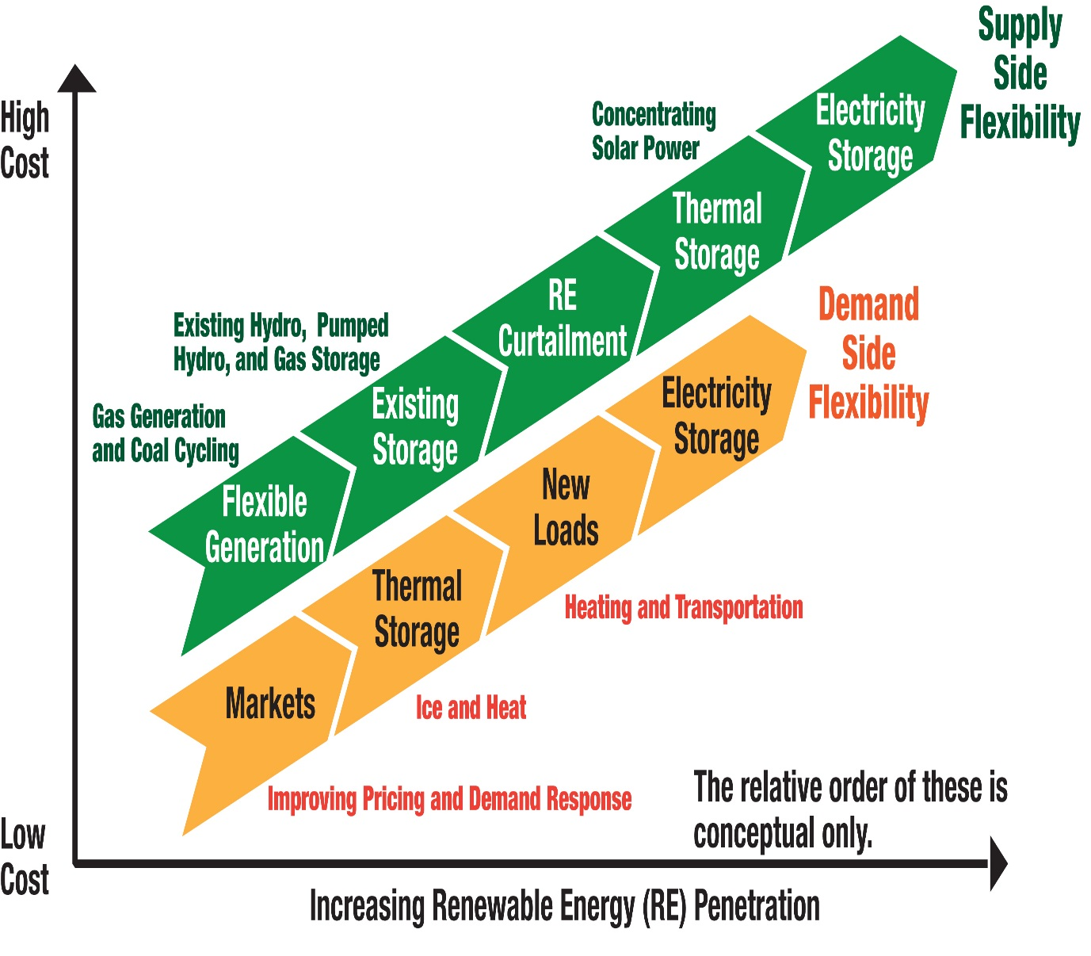
Addressing Integration: Sources of Flexibility
IMPROVED INSTITUTIONAL FLEXIBILITY
  Faster markets
  Shorter intervals for scheduling
  Balancing over a larger geographic areas
  Advanced forecasting techniques
  Better use of existing transmission
A MORE FLEXIBLE GENERATING FLEET
  Modify existing plants to increase flexibility
  New flexible generating plants
CAPABILITIES OF DEMAND RESPONSE
  Control loads with dispatch and automation
  Can act as reserve resource
ADEQUATE TRANSMISSION IS NECESSARY
ENERGY STORAGE OPTIONS
  Better use of existing pumped hydro, expand gas storage, and thermal/ice are early options
Source: NREL
  New pumped hydro, batteries, CAES, PHEVs are longer term, higher cost

Slide 32
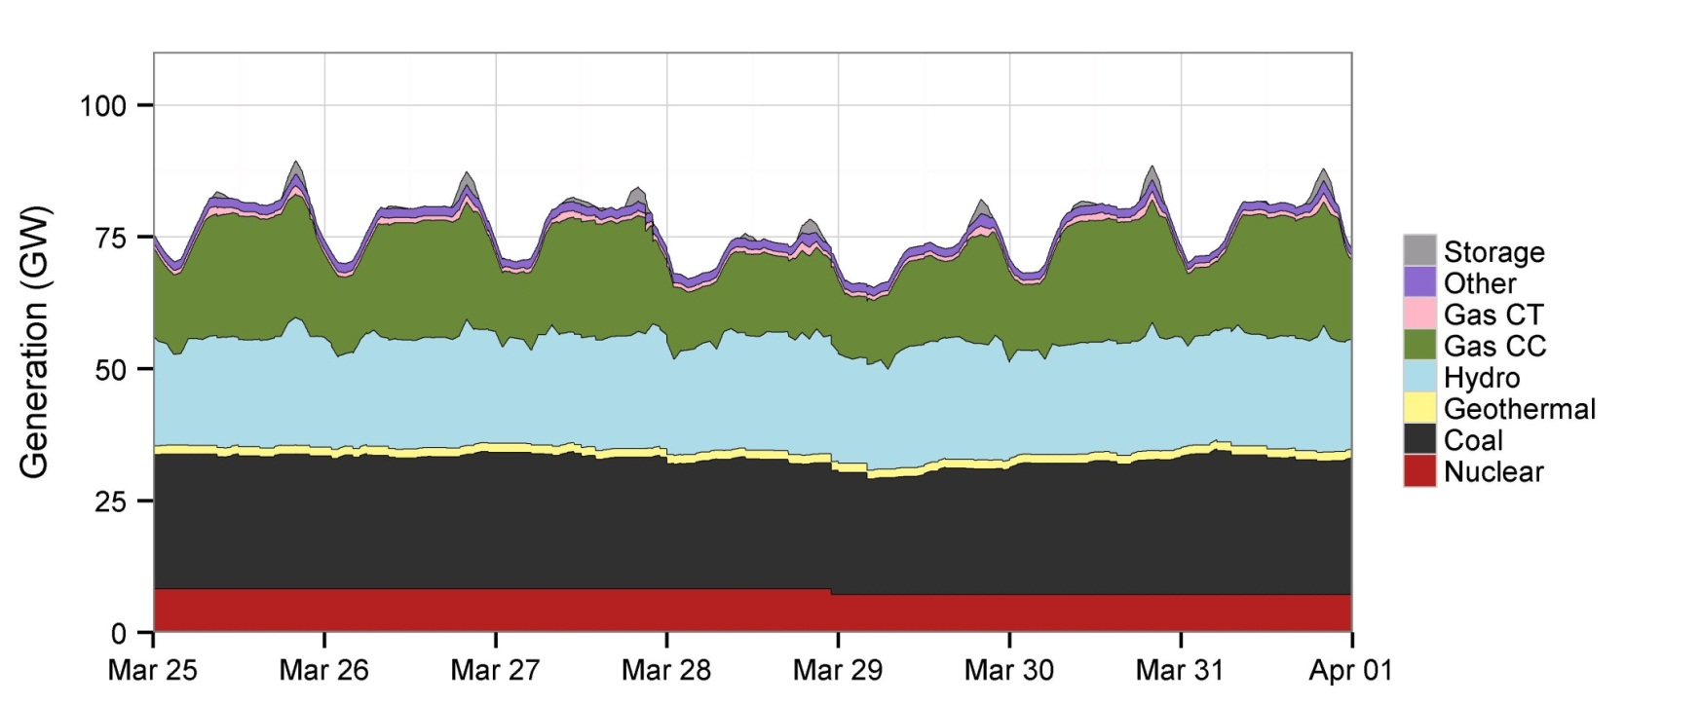
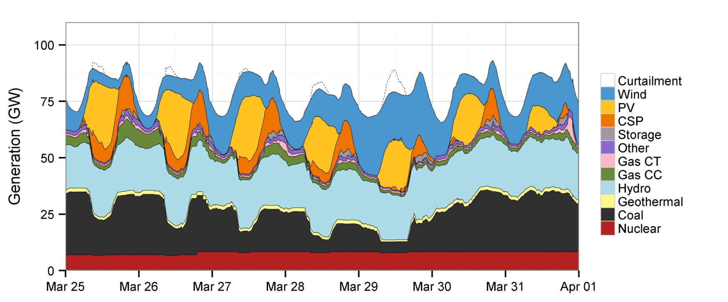
Spring Is Most Challenging for Operations
No Renewables
High Mix
16.5% wind and
16.5% solar
energy penetration
Notes:
Short

Slide 33
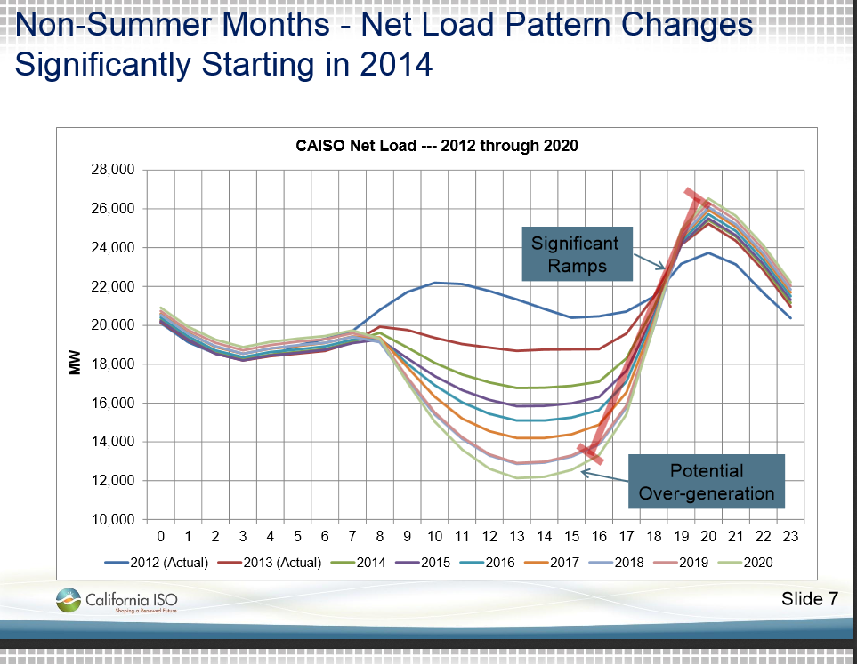
CAISO Duck curve challenges come from rapid penetration of PV
3 GW PV now,
12 GW by 2020?
Can fast moving generators, demand response, regional cooperation, (and storage?) teach the duck to fly?
Clyde Loutan presentation at UVIG Spring Meeting,
May 21, 2014 Anchorage, AK
http://www.raponline.org/featured-work/teach-the-duck-to-fly-integrating-renewable-energy by Jim Lazar
And LSSA GE report, Integrating Higher Levels of Variable Energy Resources in California, June 15, 2015

Slide 34
WGA: groupings of 9 Integration Actions
  Expand subhourly dispatch and intra-hour scheduling
  Facilitate dynamic transfers between balancing authorities
  Implement an energy imbalance market (EIM)
  Improve weather, wind and solar forecasting
  Take advantage of geographic diversity of resources
  Improve reserves management
  Retool demand response to complement variable supply
  Access greater flexibility in the dispatch of existing generating plants
  Focus on flexibility for new generating plants

Slide 35
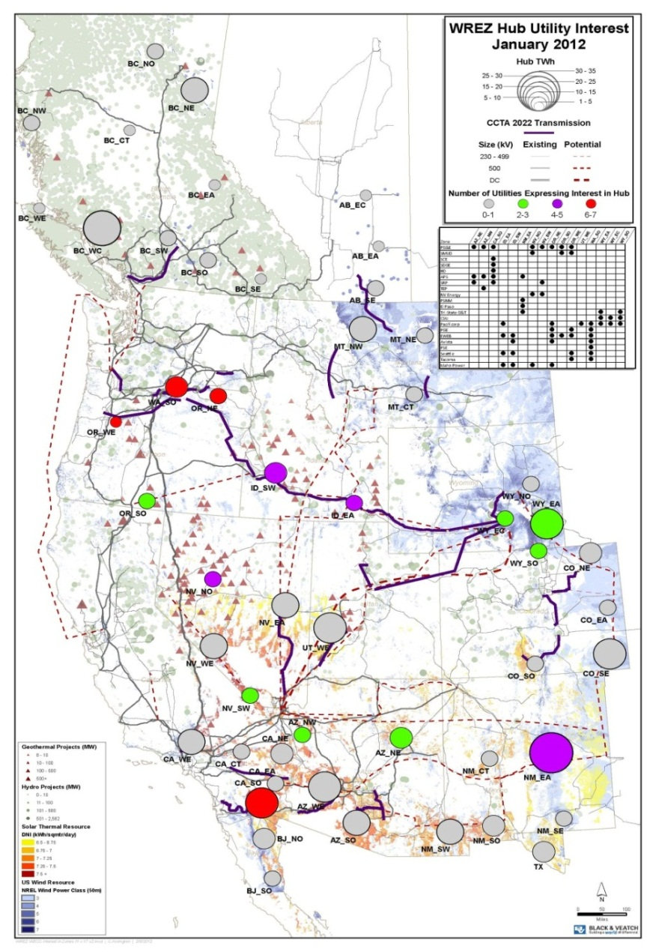

Adequate Transmission is Necessary
Renewable Energy Zones
  Proactive transmission planning
  Multi-Jurisdictional challenges
  Integral part of RE obligations and Portfolio Standards
  Cost recovery and allocation implications are critical
FERC Order 1000 regulatory action
  Intra- and Inter-Regional Transmission Planning
  Standards and Principles are established
ISO Principles Vary
  MISO, SPP, ERCOT
  Reliability, Economy Upgrades
Underlying Opportunity of Better Use of the Existing System
Western Renewable Energy Zones and Utility Interest
Notes:
All contain elements of consensus building

Slide 36
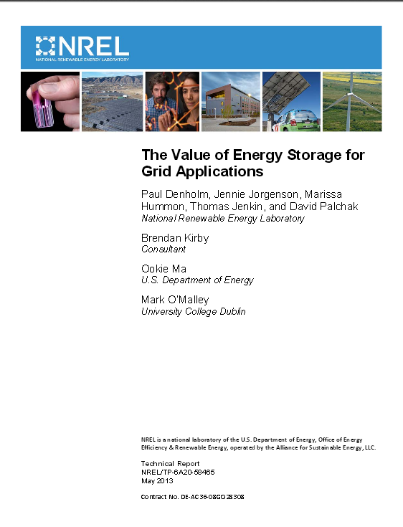
Storage
System benefits are significant but other sources of flexibility are often more cost effective
Make best use of pumped hydro: beyond peak shifting of baseload generation (Xcel Cabin Creek example)
Gas in the pipe/ground if there are deliverability issues when wind forecast is over-optimistic
Ice and building integrated thermal storage being considered for systems with increasing VRE
Concentrating Solar Power incremental storage costs are moderate and are a system resource
Batteries, compressed air, and other new concepts are in technology demonstration phases
Electric vehicles: controlled charging and possible vehicle to grid
Many ancillary services are not highly valued, or markets are absent

Slide 37
Disturbance response with high penetrations of wind and solar
Issues and Proceedings
    Retirement of Fossil – MATS, 111d
    IRP considering large amounts of new gas generation
    Consideration of an increased RPS
    Transmission expansion for Reliability (vs. Economy reasons)
    Utility trump card due to lack of understanding

Slide 38
Disturbance response with high penetrations of wind and solar
Modeling Frameworks
    Load flow (PSLF, PSSE)
    Snap-shot dispatch stack evaluation
    Key Issues:
      control settings of conventional generators (modifications and validation)
      capabilities of inverter based generation
Interconnect wide models are not well calibrated and analysis capability is not well established

Slide 39
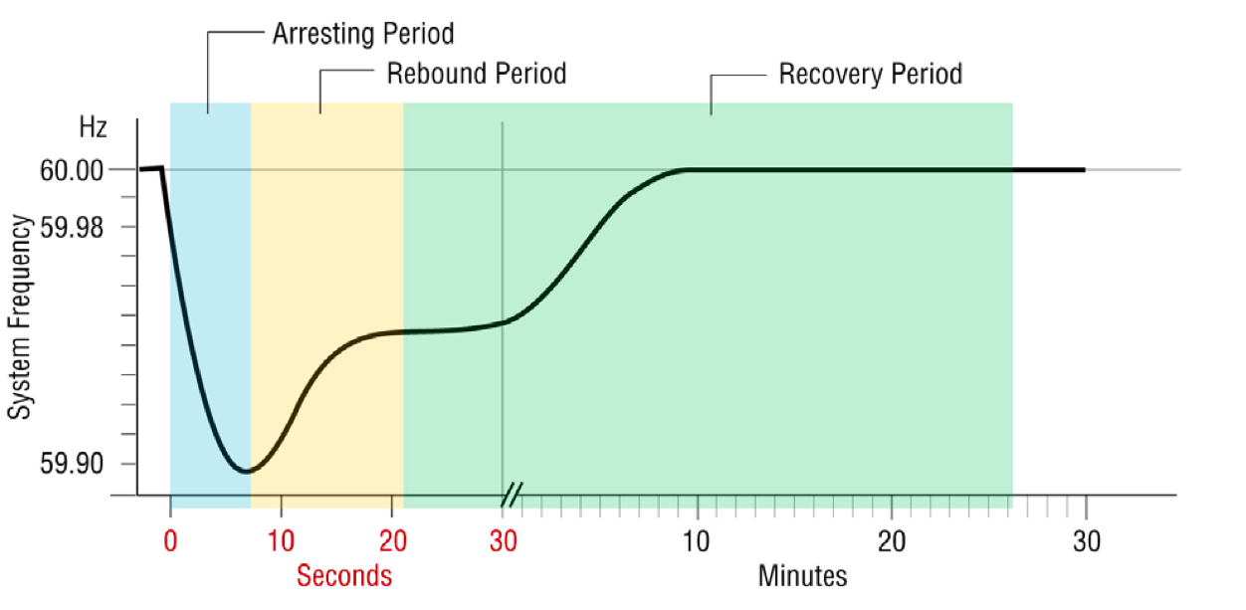
Frequency Response
Primary Frequency Control
  Inertia – spinning mass of generators and motors
  Governor response – “droop” is a generator specific set-back from maximum power
Secondary Frequency Control
  Spinning reserve, perhaps quick-start non-spin
  Automatic Generation Control triggered by signal from control room
NERC: Restore import/export to schedule in 15 minutes, all reserve levels restored in 60-90 minutes
Under Frequency Load Shedding
  Protects equipment from damage
  Envelop of allowable frequency is dependent on duration of the event
  WECC – subregional UFLS at 59.5 Hz
J. Eto, LBNL, http://www.ferc.gov/industries/electric/indus-act/reliability/frequencyresponsemetrics-report.pdf

Slide 40
Transient Stability
Alternating Current phenomena
  Rotor stability (generators stay in sync)
    Phase angle between rotor/stator in the generator can swing to instability
  Voltage stability (and reactive power balance)
    Current is needed to sustain magnetic field strength but Reactive Power does no real work
    (transmission lines, and coils like motors, transformers)
Reactive Power is a result of current and voltage being out of phase, and can not be transmitted long distances

Slide 41
VER’s require complex models to capture variability, uncertainty, and non-synchronous generator issues
“Standard” industry models may have boundary condition, time-step, data scaling, and validation limitations
Grid performance can be evaluated against various pass/fail standards, but relative changes are most insightful.
Resource Adequacy, Sequential Operations, and Disturbance Response take different modeling approaches

Slide 42
Additional modeling issues
Untapped, but available advanced inverter and control features should be reflected
Broad integration facilitation and mitigation measures, beyond current practice, should be examined
Modeling best practices continue to evolve.
Stakeholder and expert involvement is often warranted.
UVIG Technical Review Committee Principles and IEA Task 25 Best Practices for Integration Studies are useful

Slide 43
Backup slides on reactive power and transient stability
Mostly taken directly from http://westernenergyboard.org/wirab/webinars/

Slide 44
Ancillary Services (Essential Reliability Services?)
Contingency Conditions
Spinning – online, full output in 10 minutes
Non-spin – offline, but still reach full output in 10 minutes
Supplemental/replacement – 30-60 minute response; restores spin and non-spin to pre-contingency status
Adapted from Lew, WIRAB, Nov. 2014
http://westernenergyboard.org/wp-content/uploads/2014/11/11-13-14dLew_Utility_Operations.pdf

Slide 45
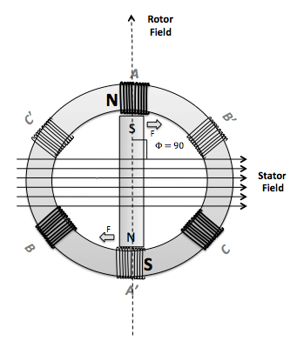
Transient Stability
Electricity is generated by moving a wire in a magnetic field
Voltage = Current times Impedance (V = I Z)
Impedance (Z) includes
  Resistance (heat)
  Inductance (magnetic fields from current)
  Capacitance (storage due to voltage differences)
Total Power = Voltage X Current (= V I = I²Z)

Slide 46
What is reactive power?
Reactive power is simply a result of the voltage and current being out of phase – it’s an AC power phenomenon
If voltage and current both go up at the same time, then real power is transmitted.
  Real power does work, like heat, light, motion
  Real power is actual net energy from the generator to your light bulb

Slide 47
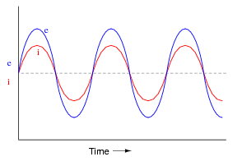
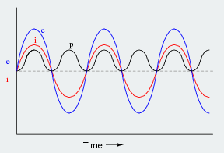
Real power (W)
Power factor = 1

Slide 48
What is reactive power?
If voltage and current are out of phase with each other, then some reactive power is transmitted.
  Reactive power doesn’t do work – it sustains the electromagnetic field
  Reactive power has a current but no net energy reaches the load
  Electrical energy sloshes back and forth between the generator and the load.
  Wires must be properly sized for this reactive current

Slide 49
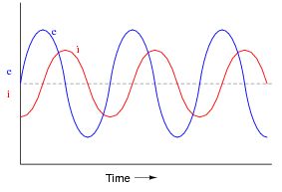
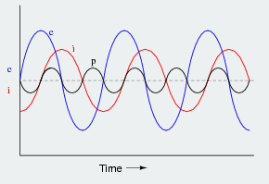
Reactive power (VAR)
Power factor = 0
Notes:
even though the current associated with reactive power does no work at the load, it heats the wires, wasting energy. Conductors, transformers and generators must be sized to carry the total current, not just the current that does useful work

