Slide 1
CAISO Stakeholder Processes and FERC Approvals
Doug Larson, Moderator

Slide 2
Notes:
To start this discussion, I’m going to put the CAISO stakeholder process and FERC approvals in context
Here’s the long-term schedule laid out by CAISO and PAC
Key takeaways are:
The CAISO stakeholder processes will generate the policies and operational procedures that become part of the CAISO tariff filings at FERC to approve an RSO and are part of the package that is presented to state PUCs for approval
It’s important for advocates to make sure those CAISO processes foster a clean energy agenda AND that the outcome of those CAISO processes does not create a stumbling block for approvals of an RSO by the CA Legislature and PUCs

Slide 3
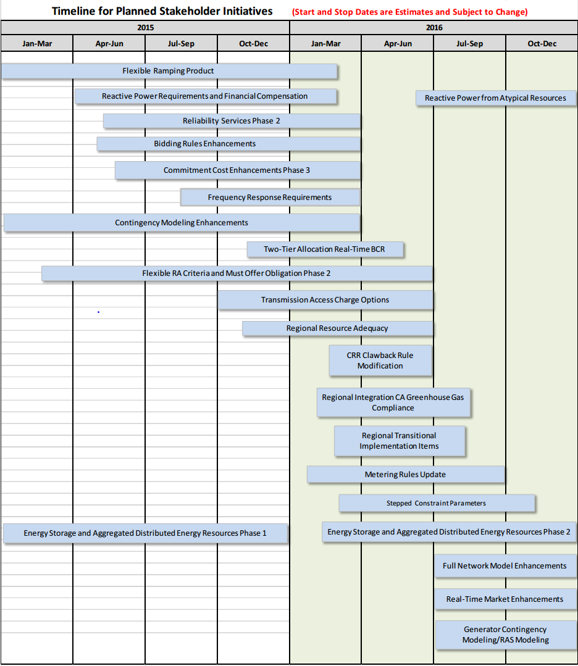
Transmission Access Charge
Issue paper in Oct
Advocate comments in Dec
WGG/WRA/NRDC/IEC comments generally align with PAC comments
CalWEA/AWEA/Interwest comments diverge
Dec 15 CAISO workshop; Jan 11 CAISO workshop; Feb 8 straw proposal
June/July CAISO Board decision
Regional Resource Adequacy
Issue paper on Dec 9
CAISO workshop on Dec 16
Comments due Jan 7
Jan 13 working group meeting; Feb 17 straw proposal
June 28-29 CAISO Board decision
Regional Integration of CA GHG Compliance
Starts in February
Should be easy – transfer EIM process to day-ahead market
Notes:
CAISO has a catalogue of stakeholder processes it is undertaking this year. SLIDE 3
This graphic summarizes all of those processes
Three of these are central to the formation of an RSO.
The three processes central to formation of an RSO are:
The Transmission Access Charge the RSO would adopt
How the RSO determines if there are adequate resources from LSEs and generators to meet load.
How to integrate California’s GHG cap and trade system into the regional markets it operates.
There are lots of important issues that affect achieving clean energy goals embedded in the other stakeholder processes
Why are these three processes central to the formation of an RSO?
Distilling the discussion on the first panel this morning and the discussion we just heard about state regulatory approvals, I think the formation of an RSO hinges on the answer to two central questions: MONEY and POWER SLIDE 4

Slide 4
Advocates challenge: Increase benefits; minimize perceived loss of state control
Ways to improve balance
Keep IRP processes intact
Use IRP results as starting point for RSO planning, but inform PUC IRP decisions with RSO integrated analysis
Let PUCs set RA requirements (but offer a default procedure they can opt into)
Ways to improve balance
Improve RSO c/b study to make more credible and a foundation for state-specific analyses
Study lower VER integration cost
Minimize TAC cost shift (don’t let the tx cost allocation “tail” wag the RSO benefits “dog”)
Money
Dispatch savings
Lower VER integration cost
Power
Fear of more FERC involvement
Less control through IRPs
Notes:
When evaluating the wisdom of PAC joining the ISO, PUCs will be weighing economic benefits their customers could derive against the potential or perceived loss of state control.
The challenge for advocates is to make that tradeoff easier by increasing the benefits from PAC partricipating in an RSO and lessening the perception of a loss of state control.
Here are some examples of ways to do this:
Improve on the E3 benefits study with new study work. That new study work would:
Better identify costs and benefits and do so in a manner that makes it easy for states to build on this work and do their own state’s c/b studies.
Study and better define the lower VER integration costs that come from forming an RSO.
Minimize cost shifts between PAC and CAISO when establishing the Transmission Access Charge. The cost of existing PAC transmission would be borne by PAC customers and cost of existing ISO transmission would be paid for by existing CAISO customers. After RSO formation, the cost of new transmission investment would be spread based on who receives the benefits.
Regarding loss of control:
Keep state PAC IRP processes intact. The results of IRP proposes would be the starting point for RSO planning. RSO planning would identify an optimum regional resource mix and that information could be fed back to the PUCs so that they could elect to change their approval/acknowledgement of the PAC IRP based on info provided by the RSO. The PUC would retain ultimate decision authority, but their decisions would be informed by the RSO’s regional optimization analysis.
All PUCs should be allowed to set RA requirements (as the CPUC does now), but have the CAISO offer a state-of-the-art RA default program that a PUC could elect to adopt in lieu of developing its own RA program.
Regarding CA’s GHG compliance program, make sure it is not adversely affected by RSO markets. I think that this is possible by extending the procedures the CAISO uses in the EIM market to other RSO markets. Some icing on the cake might be to make it easy for a state to elect to use the RSO GHG process in demonstrating compliance with GHG emissions requirements or maybe even join the CA cap and trade program.
So let me put my moderator’s hat back on and turn to John and Allison to offer their observations what advocates should be considering in the CAISO stakeholder process and approvals at FERC.
Complexity
CA fear of coal dispatch
Fear of Californiaization

