Slide 1
Low Carbon Grid Study
WCEA
San Francisco, CA
January 8, 2016

Slide 2
Low Carbon Grid Study
Carbon Emission Trajectories
CARB emissions trajectory to 2050
Baseline Case results
Target Case- Enhanced
Target-Conventional
Accelerated Case (Phase I)

Slide 3
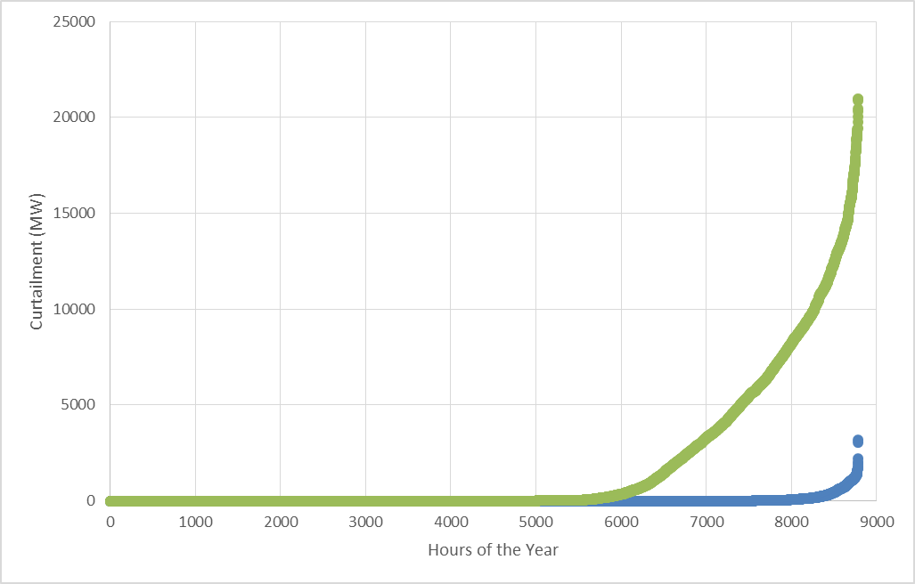
Low Carbon Grid Study
Curtailment of Renewable Energy
A: 55% renewables, conventional flexibility
case:
Solar PV dominates new procurement
No additional bulk storage
Continuation of today’s operation policies
B: 55% renewables, enhanced flexibility case:
Balanced portfolio
Additional bulk storage
Economically rational imports and exports
Renewables allowed to provide essential reliability services and flexibility
Difference in Cases: B minus A
CA Cost savings: $1.1 B/yr
CA Carbon saved: 5 MMT/year
Rest of WECC carbon saved: 2.5MMT/yr

Slide 4
Low Carbon Grid Study
Results Summary
Case | Net Cost (% of RevReq) | CA Carbon (MMT/yr) | RE Curtailment (%)
Diverse/Enhanced | 0.6% | 41.1 | 0.2%
High Solar/Enhanced | 2.2% | 42.2 | 0.5%
Diverse/Conventional | 2.3% | 45.0 | 4.2%
High Solar/Conventional | 4.1% | 46.8 | 9.7%

Slide 5
Low Carbon Grid Study
Steepest Ramp Day Dispatch (Winter)

Slide 6
Low Carbon Grid Study
Steepest Ramp Day (Winter)
Net Load: Load - Renewables
Target- Enhanced
High Solar- Conventional

Slide 7
Low Carbon Grid Study
Steepest Ramp Day (Winter)
Net Load - Imports
Target- Enhanced
High Solar- Conventional

Slide 8
Low Carbon Grid Study
Steepest Ramp Day (Winter)
Net Load – Imports - Storage
Target- Enhanced
High Solar- Conventional

Slide 9
Low Carbon Grid Study
Steepest Ramp Day (Winter)
Net Load – Imports – Storage - DR
Target- Enhanced
High Solar- Conventional

Slide 10
Low Carbon Grid Study
Steepest Ramp Day (Winter)
Net Load – Imports – Storage – DR- Hydro
Target- Enhanced
High Solar- Conventional

Slide 11
Low Carbon Grid Study
Steepest Ramp Day (Winter)
Curtailment:
Net Load – Imports – Storage – DR – Hydro - Gas
Target- Enhanced
High Solar- Conventional

