Slide 1






Lessons Learned from Existing RTOs
John Moore
January WCEA Meeting
January 7th, 2016
Notes:
WELCOME AND INTRODUCTION

Slide 2
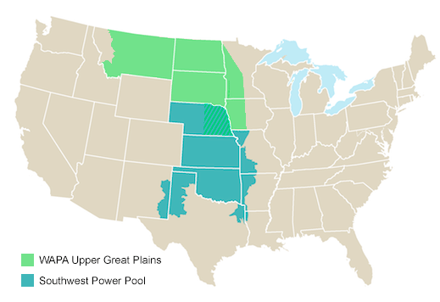
Southwest Power Pool
18 million people
56,142 miles of transmission lines
Total installed generating capacity: 77,366 MW (2015)
Historic peak demand: 45,256 MW (2013)

Slide 3
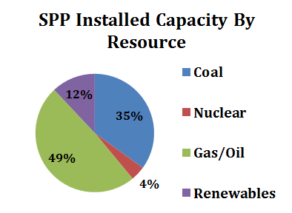
Southwest Power Pool
Renewables: >10,000 MW (including hydro from WAPA)
Wind Peak: 9,948 MW (12/19/15)
  33% of total system load

Slide 4
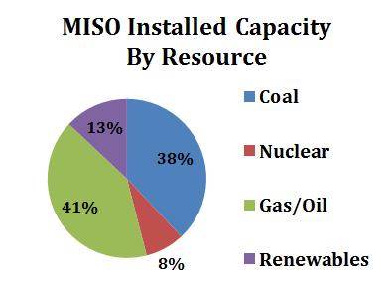
MISO
18,400 MW Renewables (2015)
  9% wind, 3% hydro, 2% other.
Wind Peak: 12,613 MW (11/19/15)

Slide 5
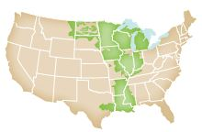
MISO
42 million people
65,800 miles of transmission lines
Total installed generating capacity: 180,711 MW (2015)
Historic peak demand: 127,125 MW (2015)

Slide 6
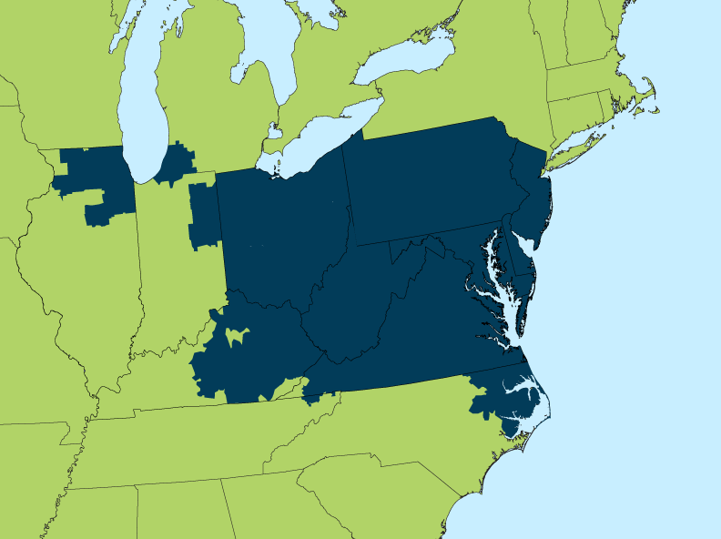
PJM
61 million people
62,556 miles of transmission lines
Total installed generating capacity: 183,604 MW (2015)
Historic peak demand: 165,492 MW (2015)

Slide 7
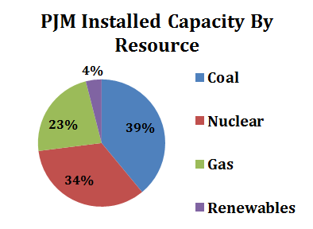
PJM
Renewables: 13,000 MW
  7 GW wind, 2.5 GW solar (350 MW utility scale).
Wind Peak: 5,588 MW (11/17/15)
  8.1% of total system load

Slide 8
Strategic Considerations
Who serves public interest?
Sector participation levels in governance and process
  States, environmental, consumer
  State reluctance and consensus issues + resource constraints for all
RTO “culture” drivers
  Utility mix
  Restructured or vertically integrated, or both
  State commissioner interest/personalities
  Influence of states, TOs, and other sectors per agreements

Slide 9
PJM Governance
PJM is an LLC; 940+ members vote on tariff changes made under FPA 205
  Weighted sector voting
  Board can act independently under 206
Strong committee role in committees; Problem Statements
Observations on Board and executive leadership
Markets rule!

Slide 10
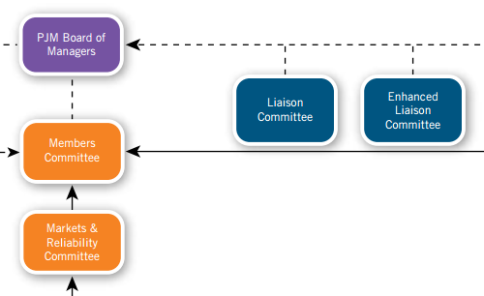
PJM Governance
16 committees, 19 subcommittees, 8 task forces, 4 user groups
Sectors: Transmission Owner, Generation Owner, Electric Distributor, End-Use Customer, Other Supplier.

Slide 11
PJM Renewables Priorities
Distributed energy resources – especially PV
  Better forecasting
  Understanding operations impacts
  FERC approved PJM’s enhanced inverter standards proposal in 2015 for all new interconnected wind and solar resources 10 kW or larger
  Battery storage
Light load criteria in planning
Congestion from MISO wind
Wind ramping product not on agenda

Slide 12
State Participation
Organization of PJM States (OPSI)
  Not a PJM member, nor are individual states
  No independent 205 filing authority
  MOU with Board for access
  Observes at Liaison Committee meetings
  Funded through PJM ($587,000 in 2014)
Independent State Agencies Committee (ISAC)
  State utility commissions, energy and environmental agency input into PJM
  Stagnant at moment, some opportunity with CPP

Slide 13
Top OPSI Interests
Limiting cost impacts of capacity market and other PJM initiatives
Strong, INDEPENDENT market monitor
Protecting state jurisdiction
Clear “beneficiary pays” cost allocation rules for Tx driven by public policies
Understanding the Clean Power Plan

Slide 14

CPP – States Awash in Modeling

Slide 15
PJM Planning and Cost Allocation
Historic focus on reliability and market efficiency planning
Increasing scenario and interregional planning
Competitive bidding on most projects
Cost Allocation
  Reliability
  Economic
  Multi-Driver Projects
    Proportional cost allocation
    Incremental cost allocation
    States pay for public policy projects - RESULT – no projects

