Slide 1







Slide 2
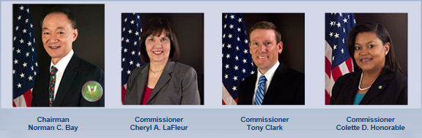
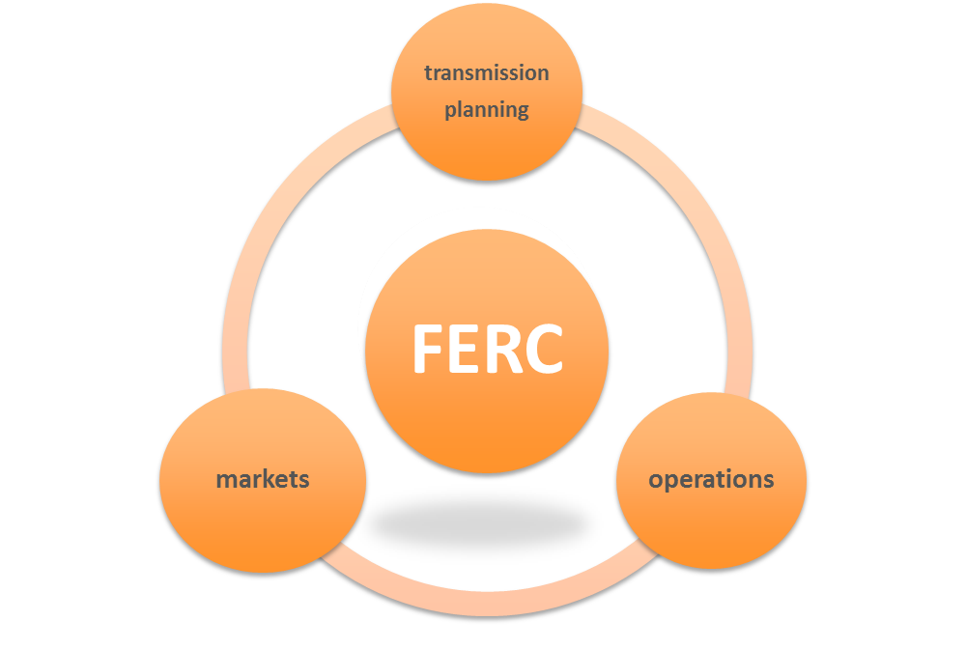
THE FEDERAL ENERGY REGULATORY COMMISSION
AUTHORITY
. . . the transmission of electric energy in interstate commerce and the sale of such energy at wholesale in interstate commerce . . .
. . . over the ERO certified by the Commission . . ., any regional entities, and all users, owners and operators of the bulk-power system, . . ., for purposes of approving reliability standards established under this section and enforcing compliance. . .
2
Notes:
Bay = 2018
LaFleur = 2019
Clark = 2016
Honorable = June 2017

Slide 3

FERC and CLEAN ENERGY
Order 888 (1996) – Open access
Order 2000 (1999) – RTOs
Order 890 (2007) – Increasing transparency in transmission service and requiring local planning
Order 745 (2011) – Compensation for demand response in wholesale energy markets
Order 1000 (2011) – Requiring regional planning and cost allocation, removal of ROFR
Order 755 (2011) - Compensation for frequency regulation in RTOs/ISOs
Order 764 (2012) – Integration of variable resources
Order 792 (2013) – Small generator interconnection procedures
3

Slide 4
ORDER 2000 ENCOURAGES RTOS
89 FERC ¶ 61,285; Dec. 20, 1999
RTO MINIMUM REQUIREMENTS
Characteristics:
1. Independence
2. Scope and Regional Configuration
3. Operational Authority
4. Short-term Reliability
Functions:
1. Tariff Administration and Design
2. Congestion Management
3. Parallel Path Flow
4. Ancillary Services
5. OASIS and Total Transmission Capability and Available Transmission Capability
6. Market Monitoring
7. Planning and Expansion
8. Interregional Coordination
The role of the RTO is to “be independent and able to provide reliable, non-discriminatory and efficiently priced transmission service to support competitive regional bulk power markets.”
4

Slide 5
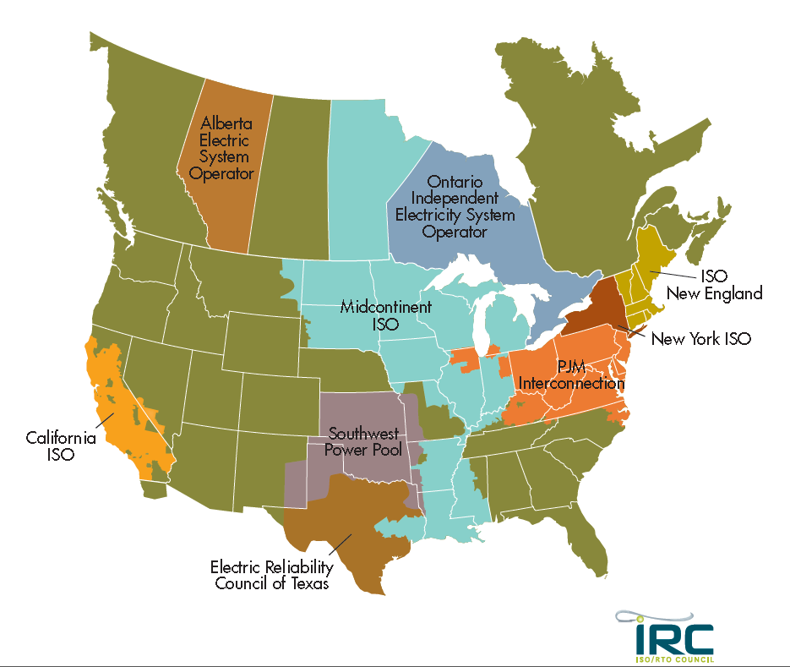
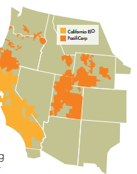
5

Slide 6
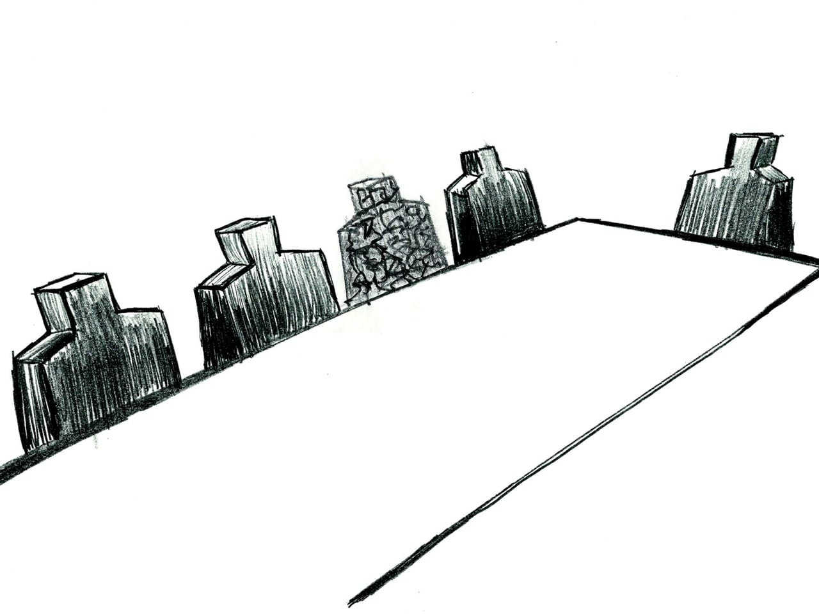
POTENTIAL RSO ISSUES – BOARD OF DIRECTORS
Order 2000 requires independence, scope and regional configuration, operational authority and short-term reliability responsibility.
In 1996, CAISO’s originating statute (AB 1890) required that CAISO’s board include representatives from 11 sectors: investor-owned utilities, public utilities, non-utility electric sellers, public buyers and sellers, private buyers and sellers, industrial end-users, commercial end-users, residential end-users, agricultural end-users, public interest groups, and nonmarket participant representatives
In 2001, CA Legislature required replacement of existing board with 5-member, governor-appointed board (FERC proposed a competing structure)
In 2004, in CAISO v. FERC, the D.C. Circuit determined “FERC has no authority to replace the selection method or membership of the governing board of an ISO, let alone to compel a corporation created by state law to employ a governing board chosen in violation of that law.”
6

Slide 7
 | ISO-NE | NYISO | PJM | MISO | SPP
Number | 10 | 10 | 10 | 10 | 7-10
Term Length | 3 | 4 | 3 | 3 | 3
Term Limit | 3 (but can waive) | 3 | n/a | 3 (but can waive) | n/a
Qualifications | ”The Nominating Committee will solicit input from Governance Participants and regulators on the types of expertise . . . needed to ensure that ISO has sufficient knowledge and expertise to act as the RTO for New England.” | cross-section of skills and experience (such as FERC electric reg affairs, utility mgt, corp finance, bulk power systems, HR, power pool operations, public policy, consumer advocacy, envtl affairs, mgt, law, markets and information systems) | 4 – corp leader, or finance, acting, engineering, law/regulation 1 – operations 1 – planning 1 – markets | 6 – corp leader, or finance, acting, engineering, law/regulation 1 – operations 1 – planning 1 – markets | 4 – corp leader, or finance, acting, engineering, law/regulation 1 – operations 1 – planning 1 – markets
Nominating Committee | up to 6 NEPOOL reps from different sectors) + 1 NECPUC rep + up to 7 BOD) | Management Comm (including sector reps) makes 3 recommendations to the NC for each seat; NC can take the recommendations or choose others | 1 rep elected annually per membership sector by others in sector + 3 BOD | 2 members chosen by Advisory Comm + 3 BOD | 9 membership sector reps + 2 BOD
Election/ Appointment Process | NC sends slate to NEPOOL Participants Committee (PC); with supermajority, NC presents slate to BOD for a vote; if PC does not endorse, NC brings a second slate, substituting a new nominee for at least one of the initial nominees; if PC again fails to endorse, NC brings either of the two slates to BOD for a vote | NC sends recommendations to the BOD, which chooses | NC sends slate to Members Comm (no public interest representation) | NC sends 2 recs per open seat; BOD nominates 1 per seat; Members elect or reject by simple majority | NC recommends 1 per seat; addtl nominations allowed w/ 20% membership support; elected by super majority of members
Public interest participation? | Yes, envtl groups are part of NEPOOL’s End User sector in the Participants Committee | YES, envtl groups are a sector in the Members Comm | No, envtl groups can’t join Members Comm (but consumer advocs can) | Yes, member of the Advisory Comm’s envtl/other sector | Yes, sectors include “alt power/public interest” and “small retail”

Slide 8
POTENTIAL RSO ISSUES – STAKEHOLDER PARTICIPATION
ISO-NE | NYISO | PJM | MISO | SPP
Transmission Generation Suppliers Publicly Owned Alternative Resources End Users | Generation Other Suppliers Transmission End-use Customers Publics/Envtl Parties | Transmission Generation Electric Distributors End-Use Customers Other Suppliers | Transmission IPPs Power Marketers/Brokers Munis/Coops/TDUs Consumer advocates (non-members) States (non-members) Envtl/Other (non-members) End Users Coordinating Members Competitive Transmission | Investor-Owned Utilities Municipals Cooperatives IPPs/Marketers Alternative Power/Public Interest Independent Transmission Large retail customers Small retail customers
8

Slide 9
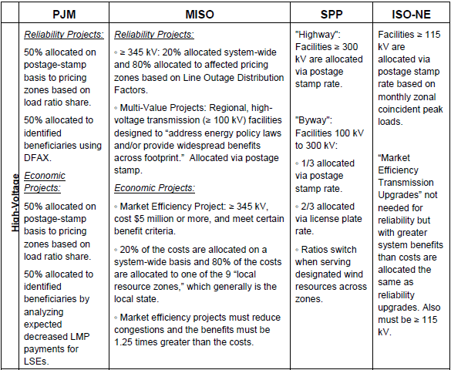
POTENTIAL RSO ISSUES – COST ALLOCATION
Benefits metrics’ determination is hard and FERC is reluctant to proscribe
Critical to capture public policy-driven benefits
9

Slide 10


POTENTIAL RSO ISSUES – RESOURCE ADEQUACY
Resource adequacy a struggle in all RTOS – top down (PJM) and bottom up (MISO)
In Order 1000 process, failed to make progress in aligning state IRP and regional planning timelines
Preserving state perrogatives v. maintaining strong CA clean energy policies
In Eastern Interconnection, States have limited bandwith, resources and in some cases, demonstrated interest in participating in RTO processes
10

Slide 11
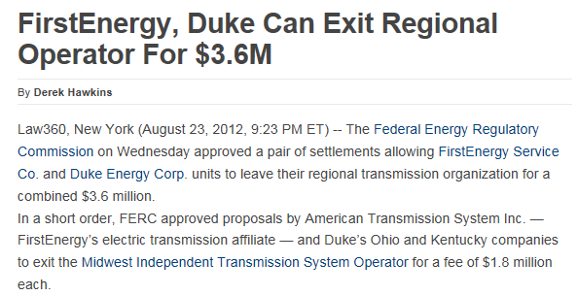
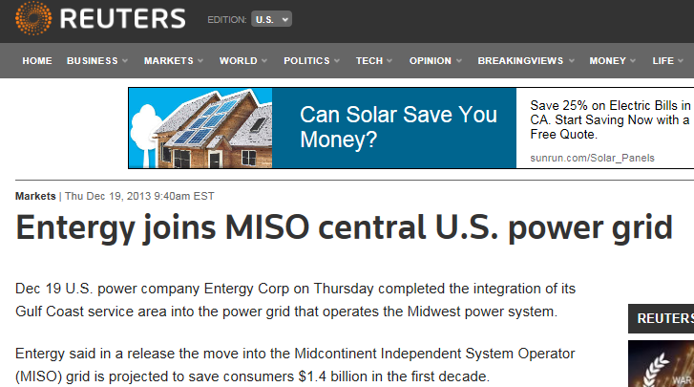
POTENTIAL RSO ISSUES – ALLEGIANCE TO MEMBERSHIP
11

Slide 12

FERC INVOLVEMENT IN RSO PROCESS
Some changes will require CAISO/PacifiCorp Section 205 filings (NGOs can intervene)
Difficult to make upward progress on substance once at FERC
FERC currently in “wait and see” mode
Pre-filing meetings key
Relevant FERC staff:
Chairman Bay’s office – Bethany Dukes
Other Commissioners/staff
Office of Energy Market Regulation – Jaime Simler, Steve Rodgers
12

