Slide 1
Clean Power Plan
Western Clean Energy Advocates
January 8, 2016

Slide 2

Because no meeting is complete without a Clean Power Plan conversation

Slide 3
Goals
Review Current Engagement Opportunities
Discuss What WCEA Can/Should Add to CPP Efforts
Develop Action Items

Slide 4
Current Engagement Opportunities
State Based Conversations
  Climate Action Campaign: Field Programs in Colorado and Montana. Some engagement with businesses and State officials in WA, OR, and CA.
  Hub States: State based efforts in politically important states. Colorado, Nevada, and Montana
Larger Conversations
  Bi-Weekly National Calls
  Bi-Weekly Regional Calls

Slide 5
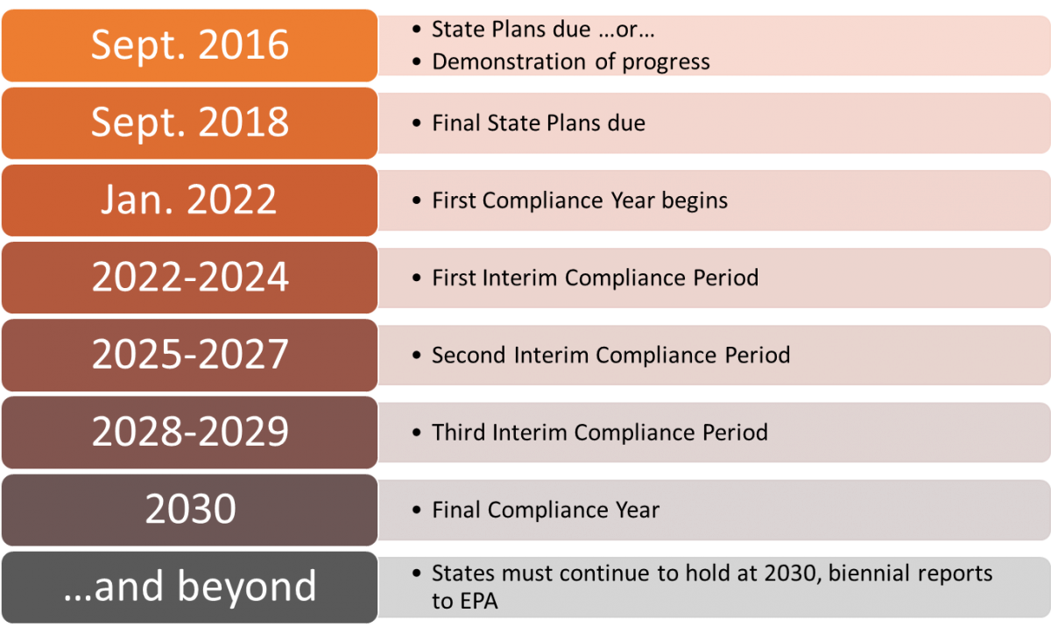
Timeline

Slide 6
2016
Comment Opportunity: Federal Plan and Model Rules - Deadline 1/21/16
Legal Defense
Legislative Defense
  Efforts likely targeted at process issues
State Plan Development

Slide 7
What Can WCEA Add to CPP Efforts?
Work in Progress
  Rate v. Mass
  Allocation
  Over supply of credits
Future Issues
  Market Issues
  Reliability
  Transmission(?)
  Regional Planning Efforts (?)

Slide 8
  Review Action Items

Slide 9
Justin Wilson
Western Clean Energy Campaign
justin@westerncec.org

